Slide 1

MEDICAL ADVISORY COMMITTEE MEETING
JUNE 2025

Slide 2
Meeting Information
Zoom:
Meeting ID: 872 3738 4805
Passcode: 429320
In Person Attendance::
Quincy Fire Department
505 Lawrence St
Quincy, California
95971

Slide 3
Agenda
Welcome & Introductions
Completed & Approved Policies
Current Policy & Treatment Guidelines Updates & Discussion
Policies & Treatment Guidelines (Slides 6-20)
Provider updates
Nor-Cal EMS Updates
Open Discussion
Run Review (optional)
Steps to get CEU
Meeting Schedule

Slide 4
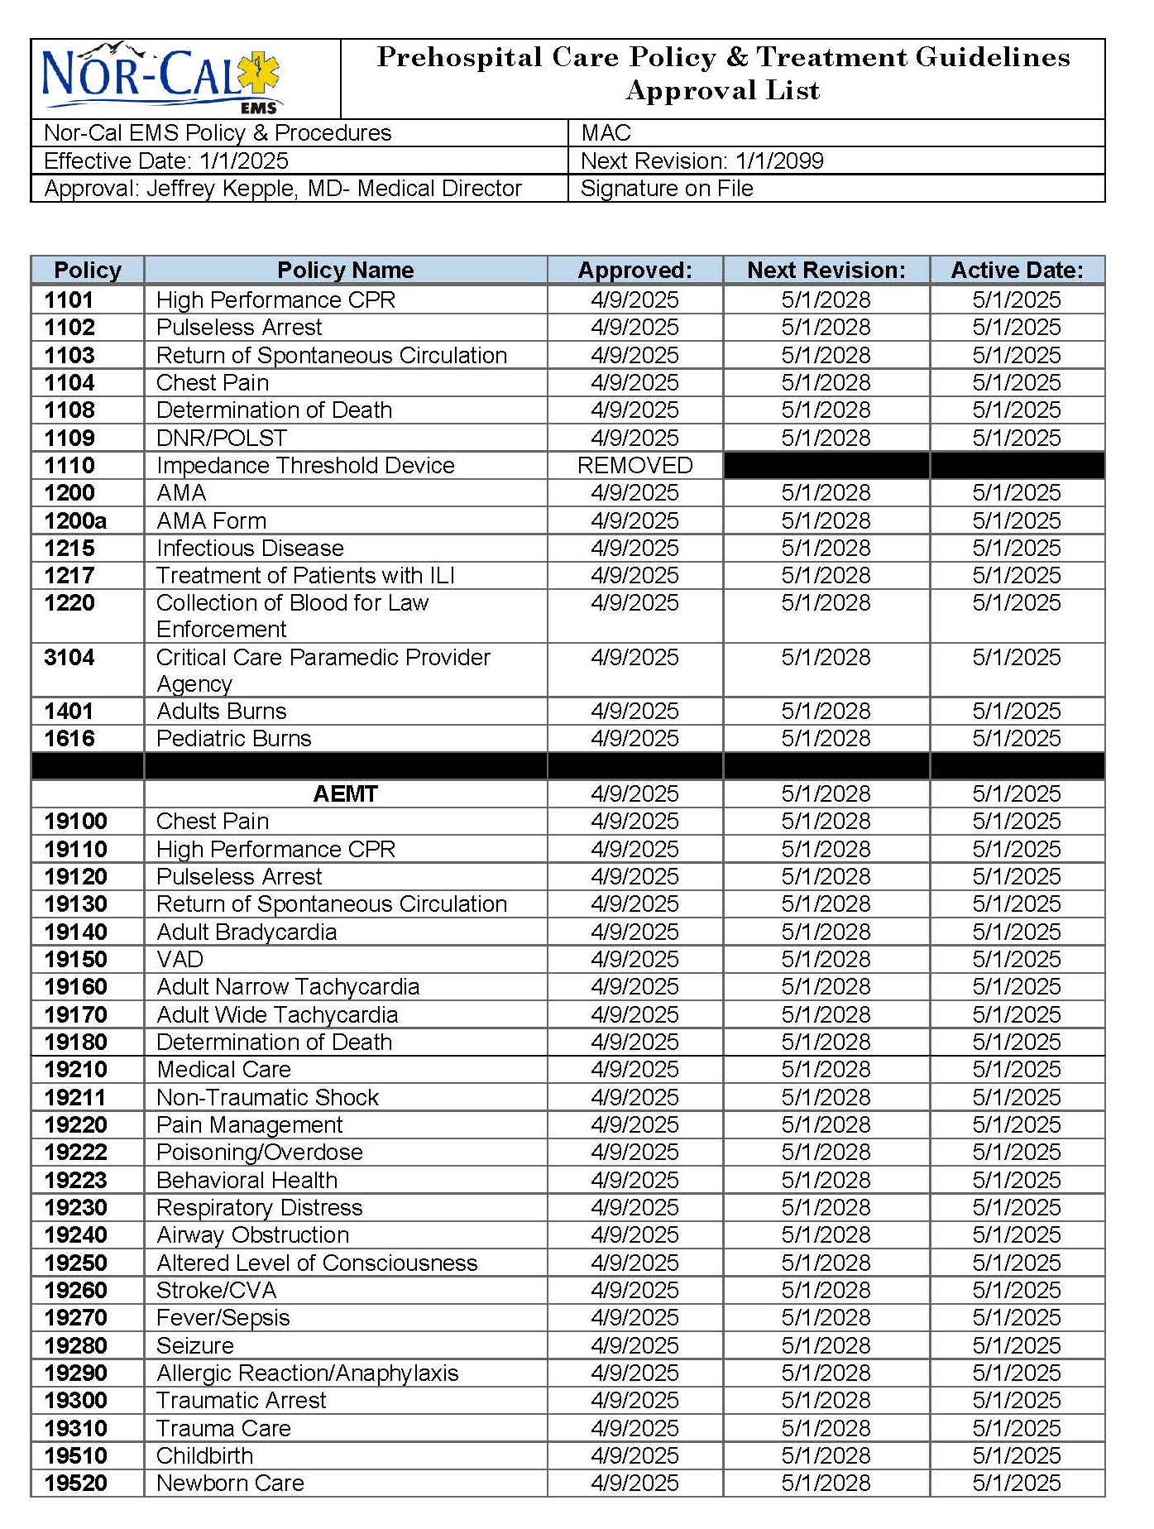
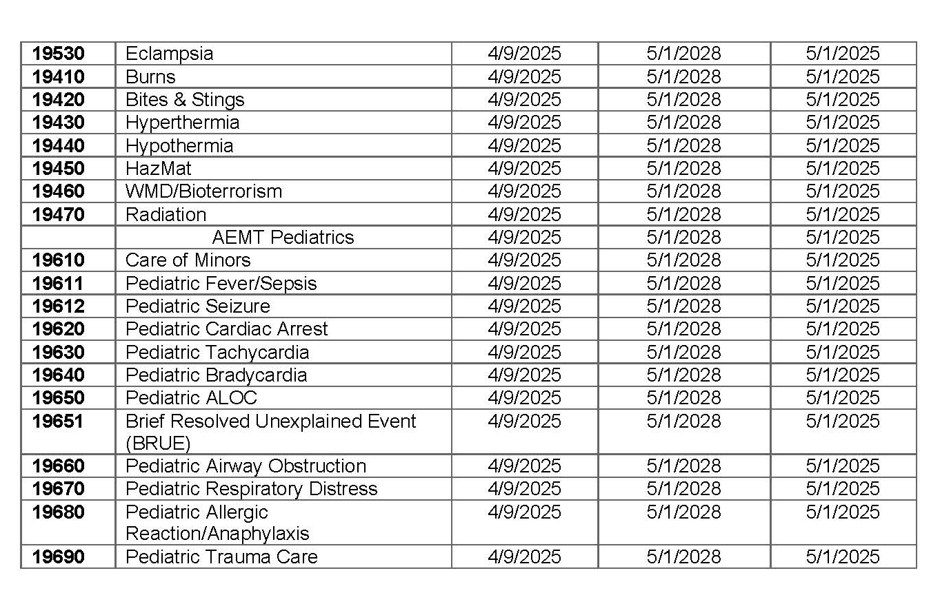
Completed & Approved Policies

Slide 5
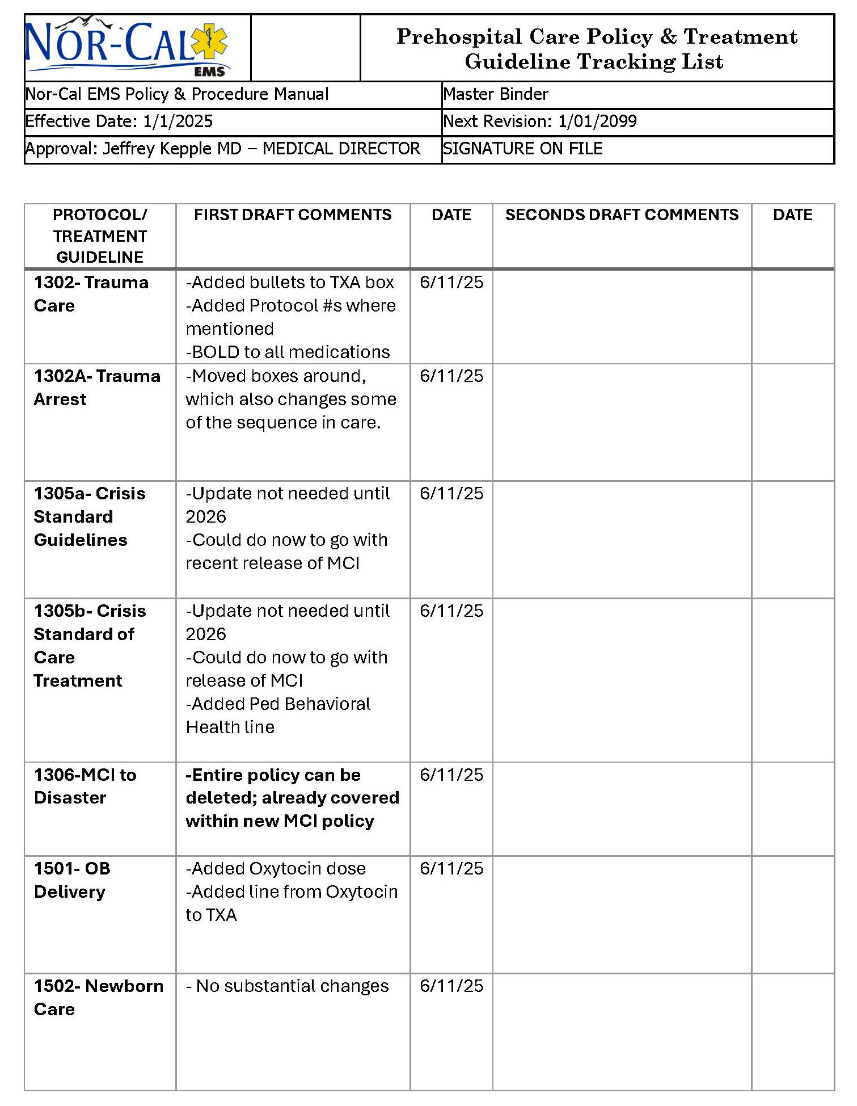
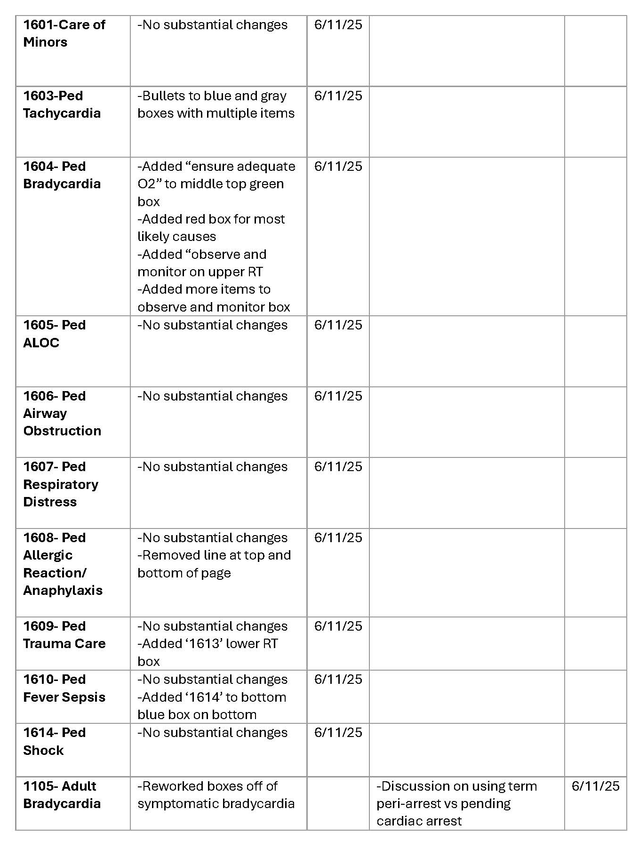
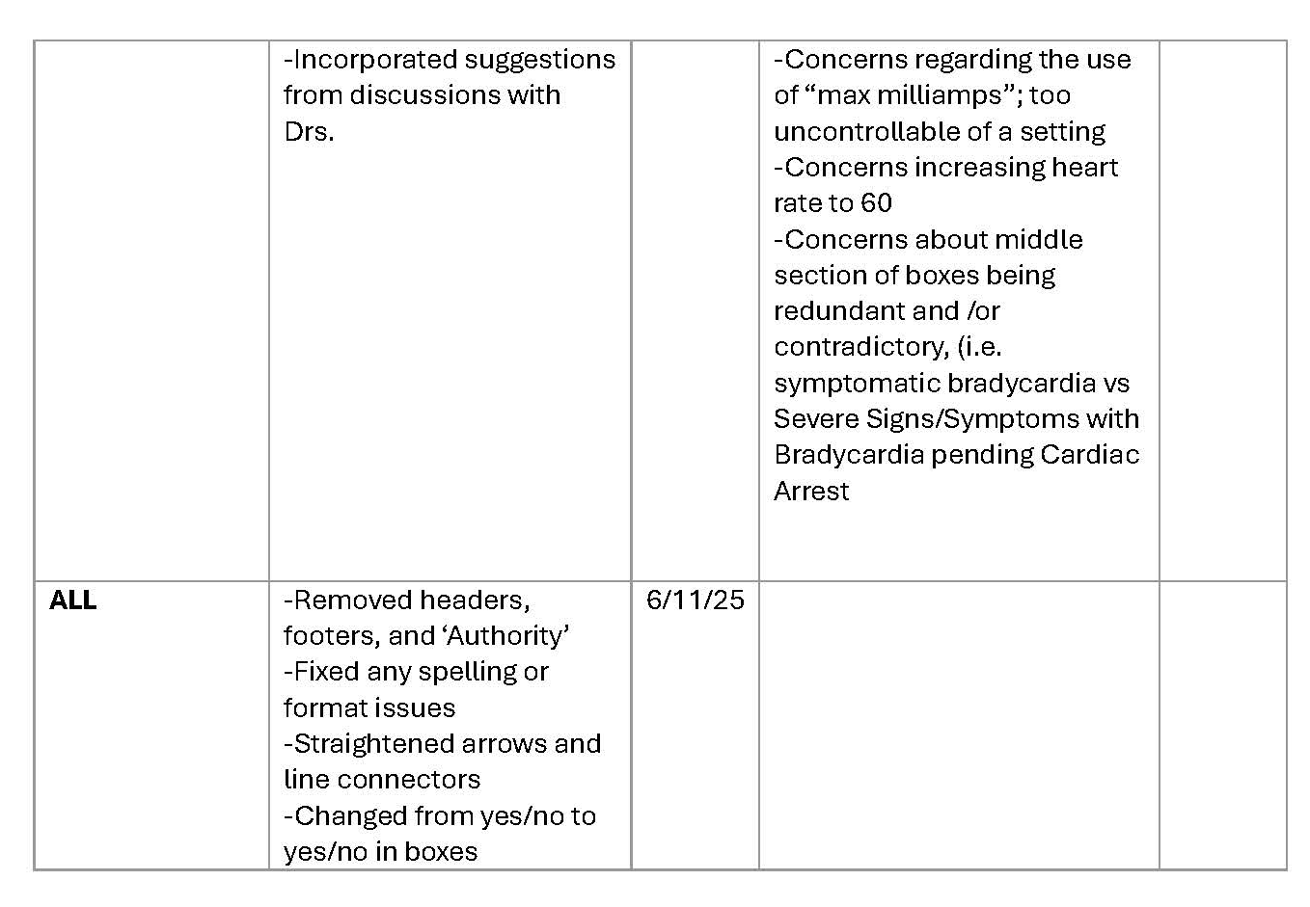
Page 2
Page 3
Prehospital Care Policy & Treatment Guideline Tracking List
Page 1

Slide 6
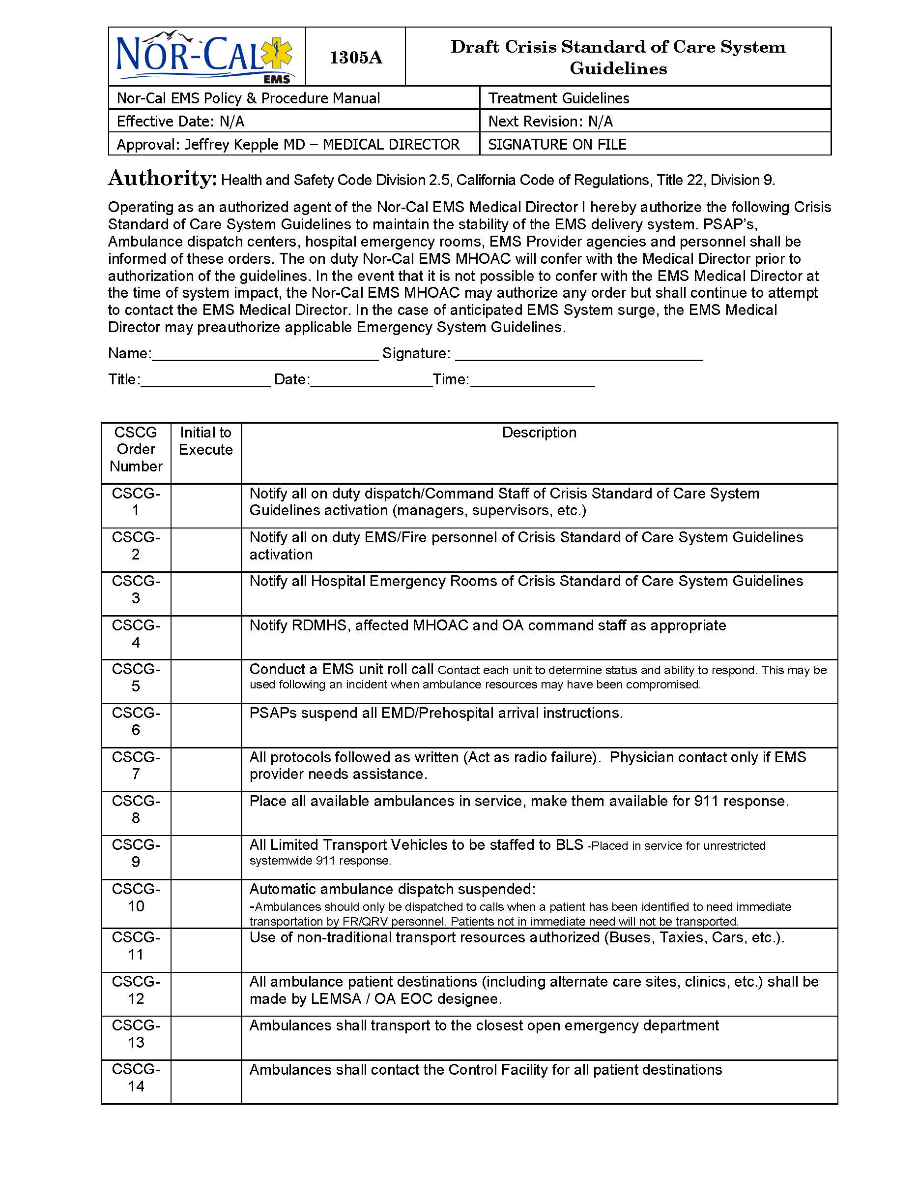
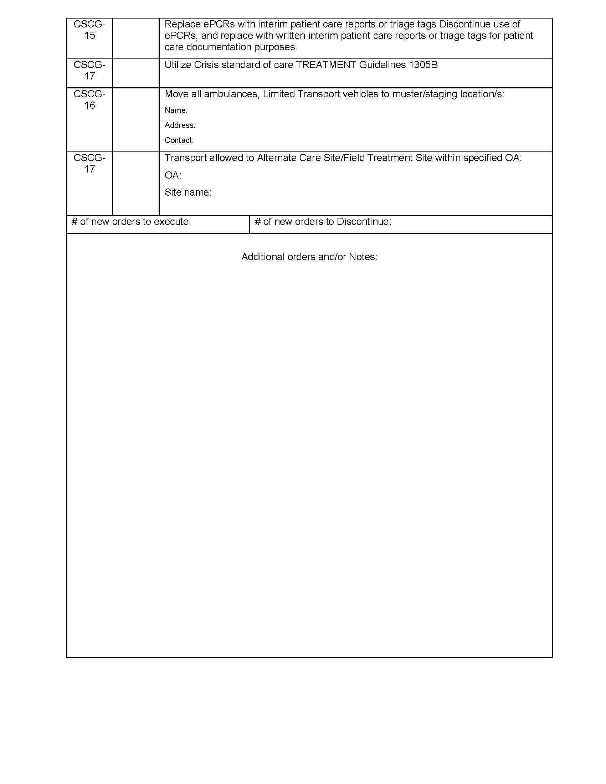
Crisis Standard of Care System Guidelines

Slide 7
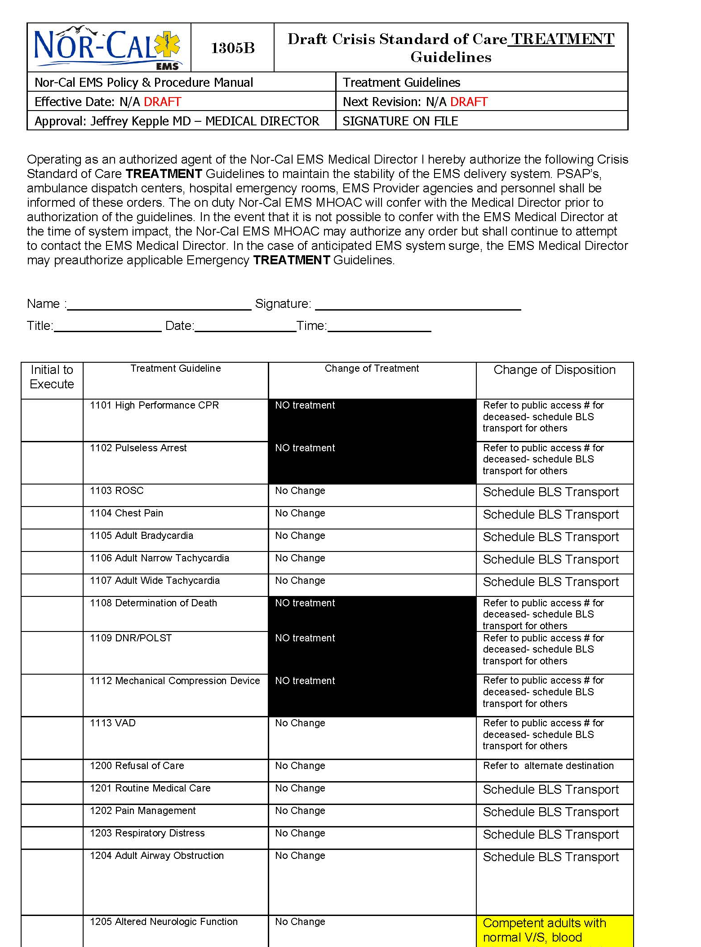
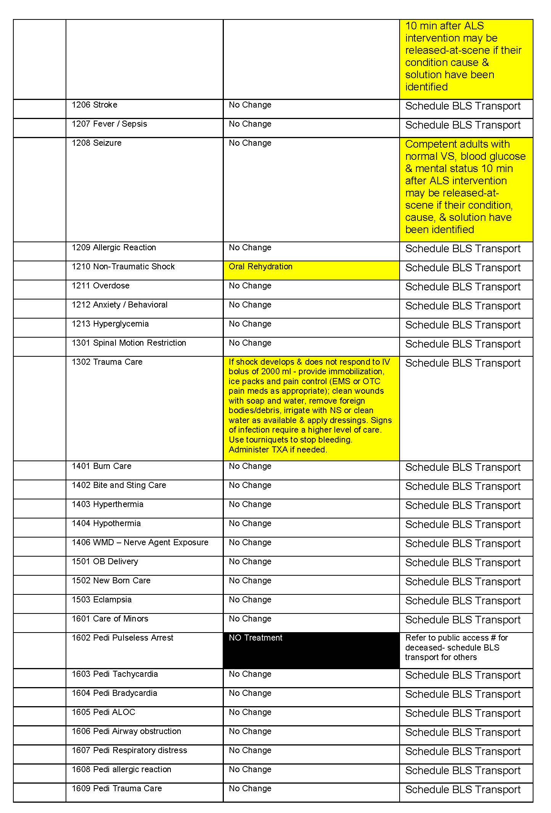
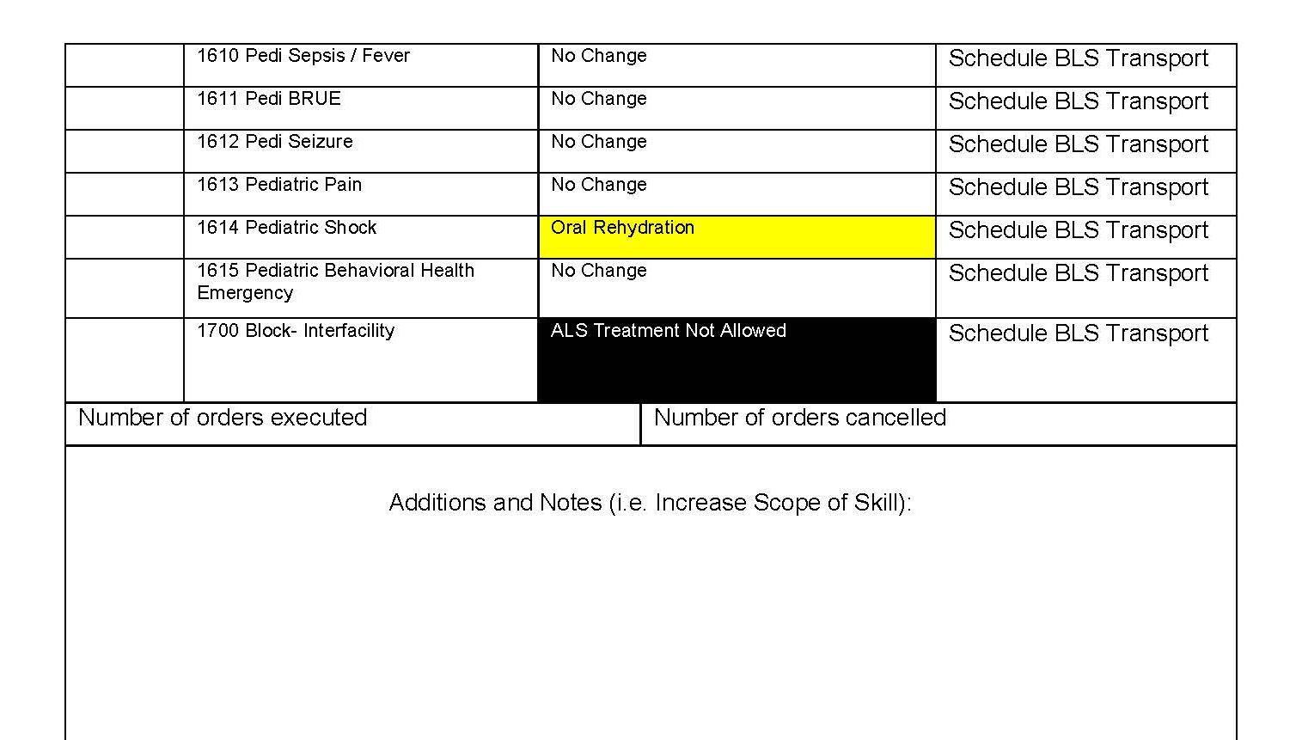

Slide 8
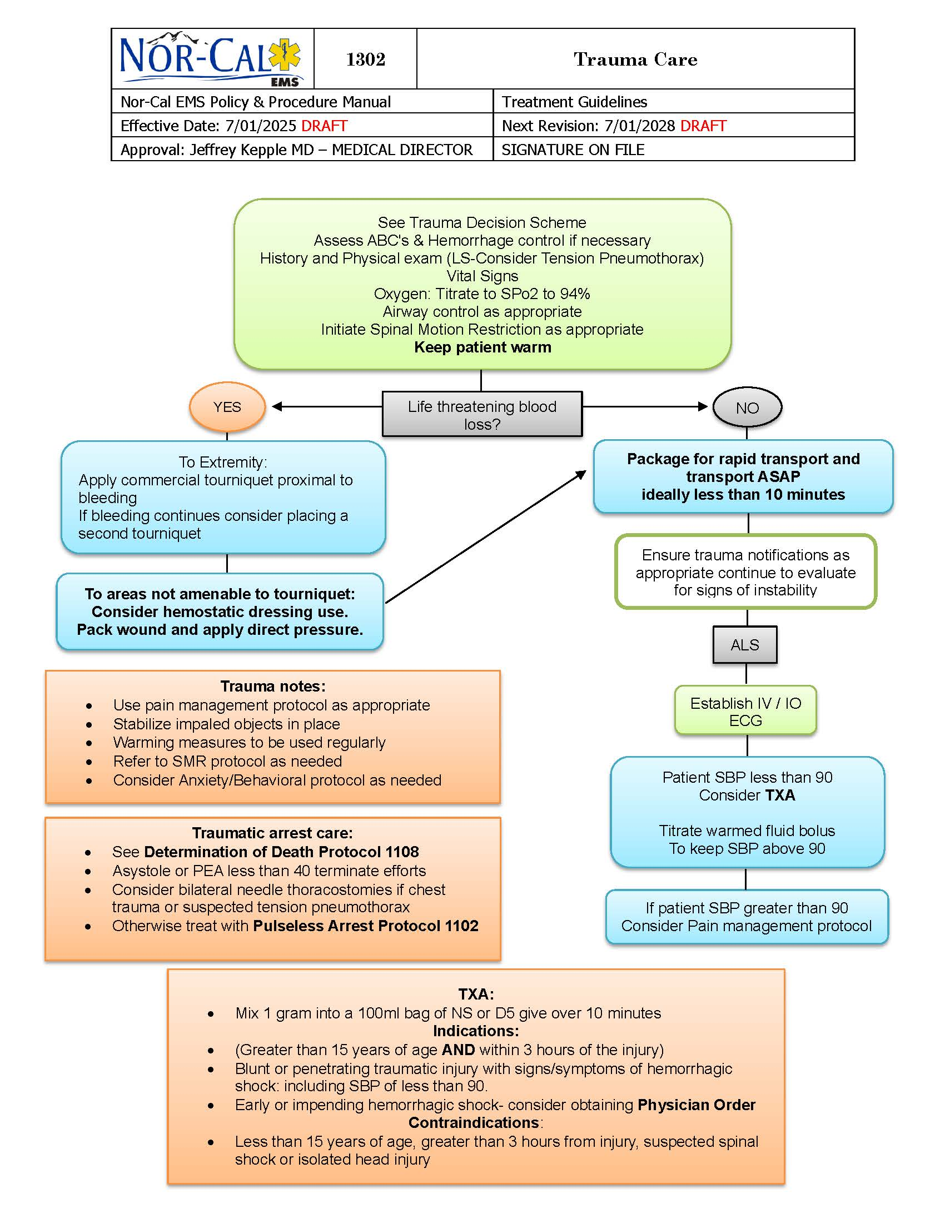
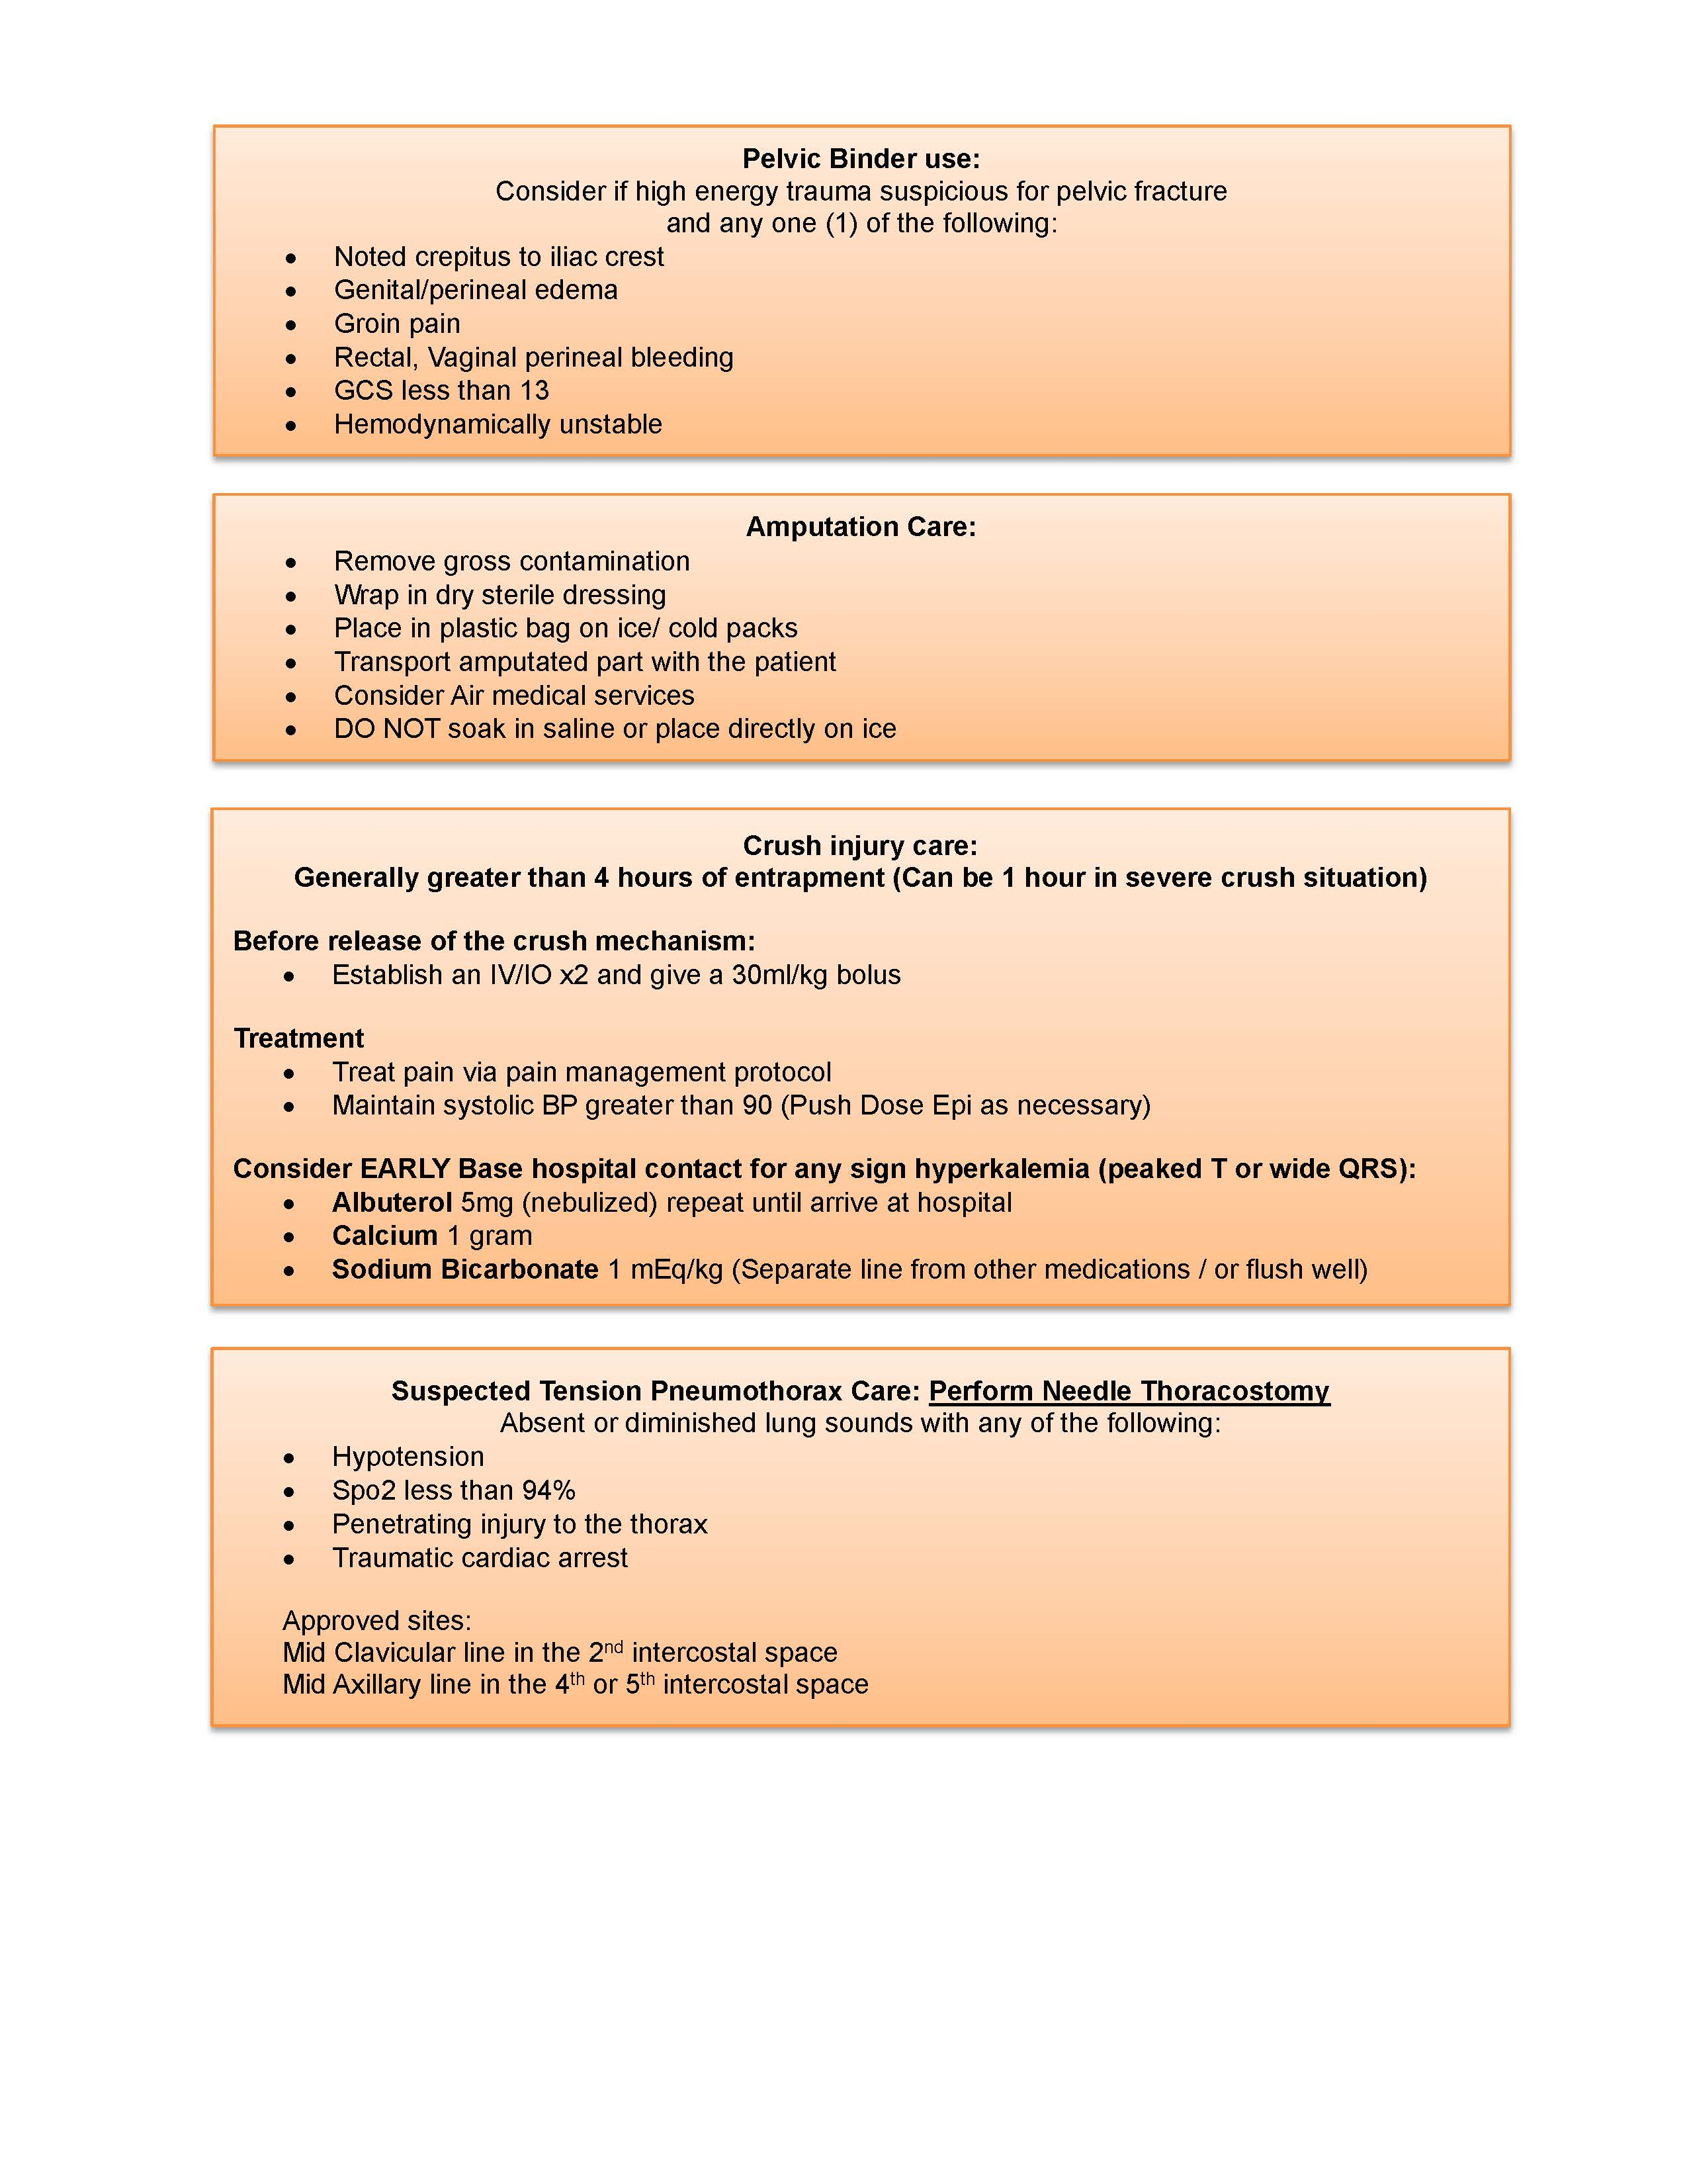
Trauma Care

Slide 9
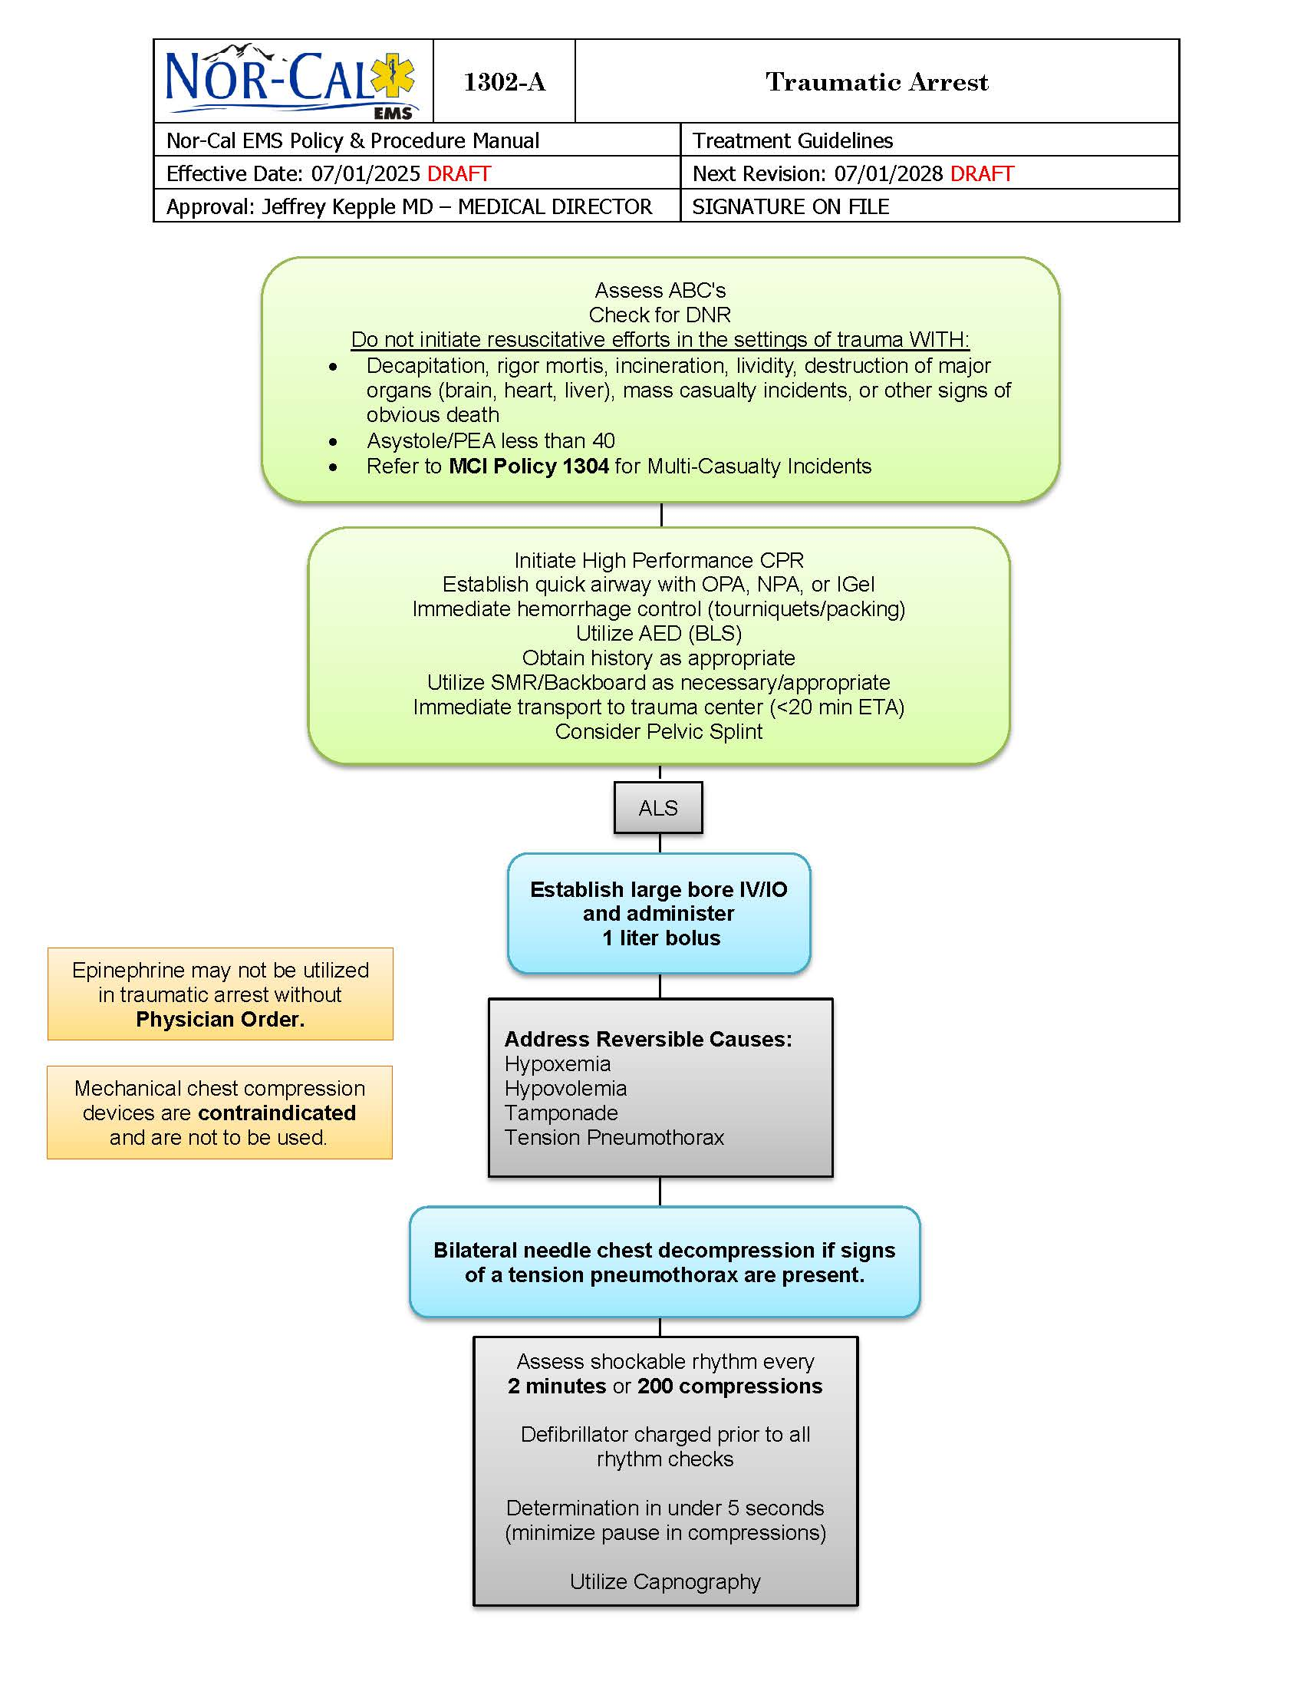
Traumatic Arrest

Slide 10
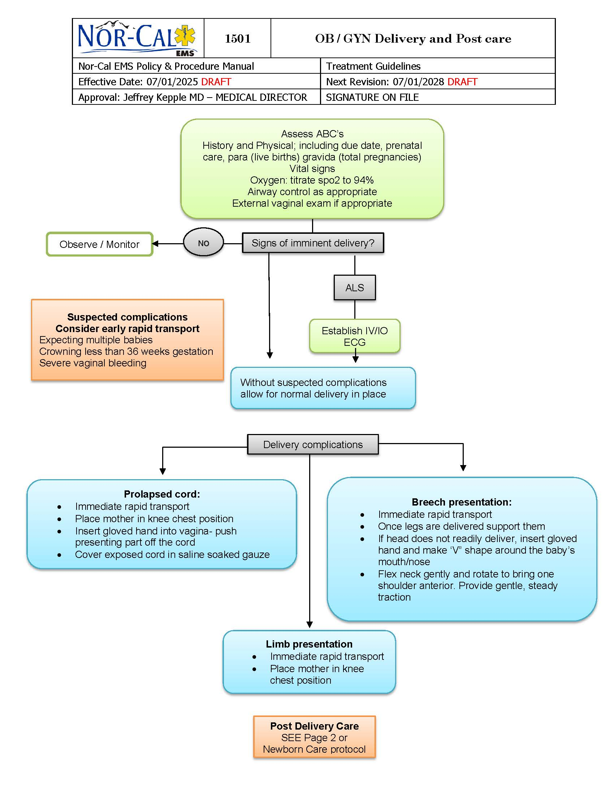
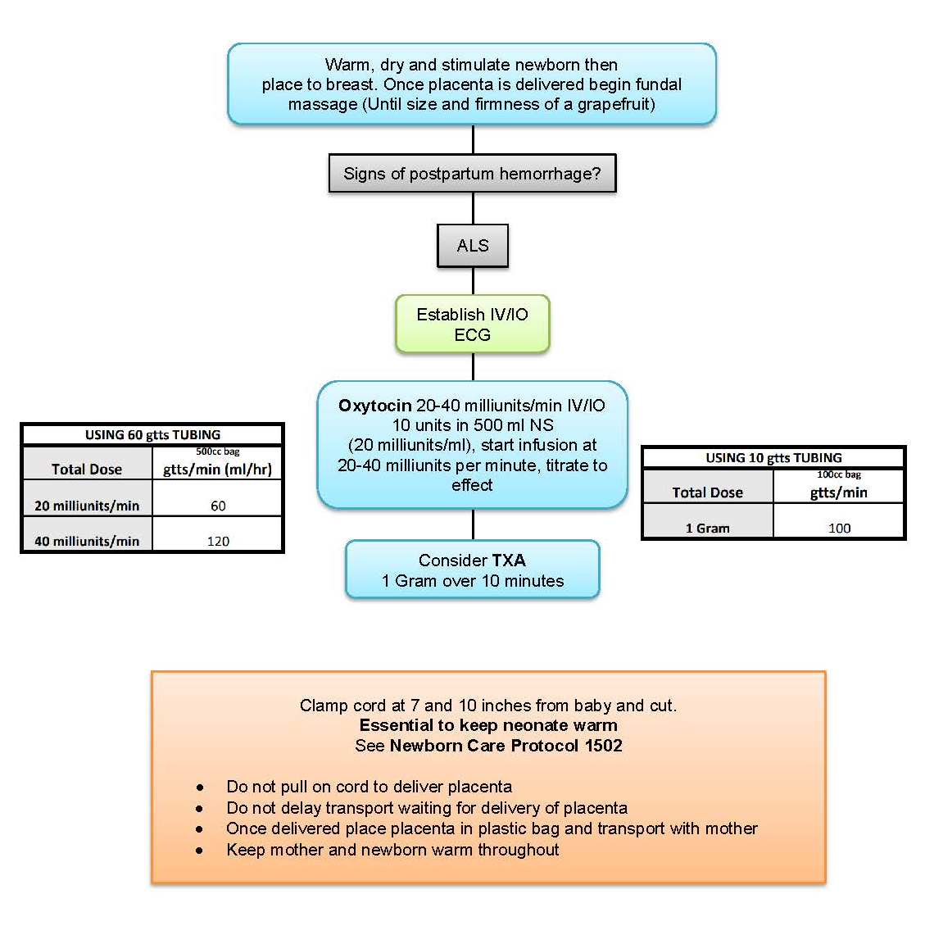
OB/GYN Delivery & Post Care

Slide 11
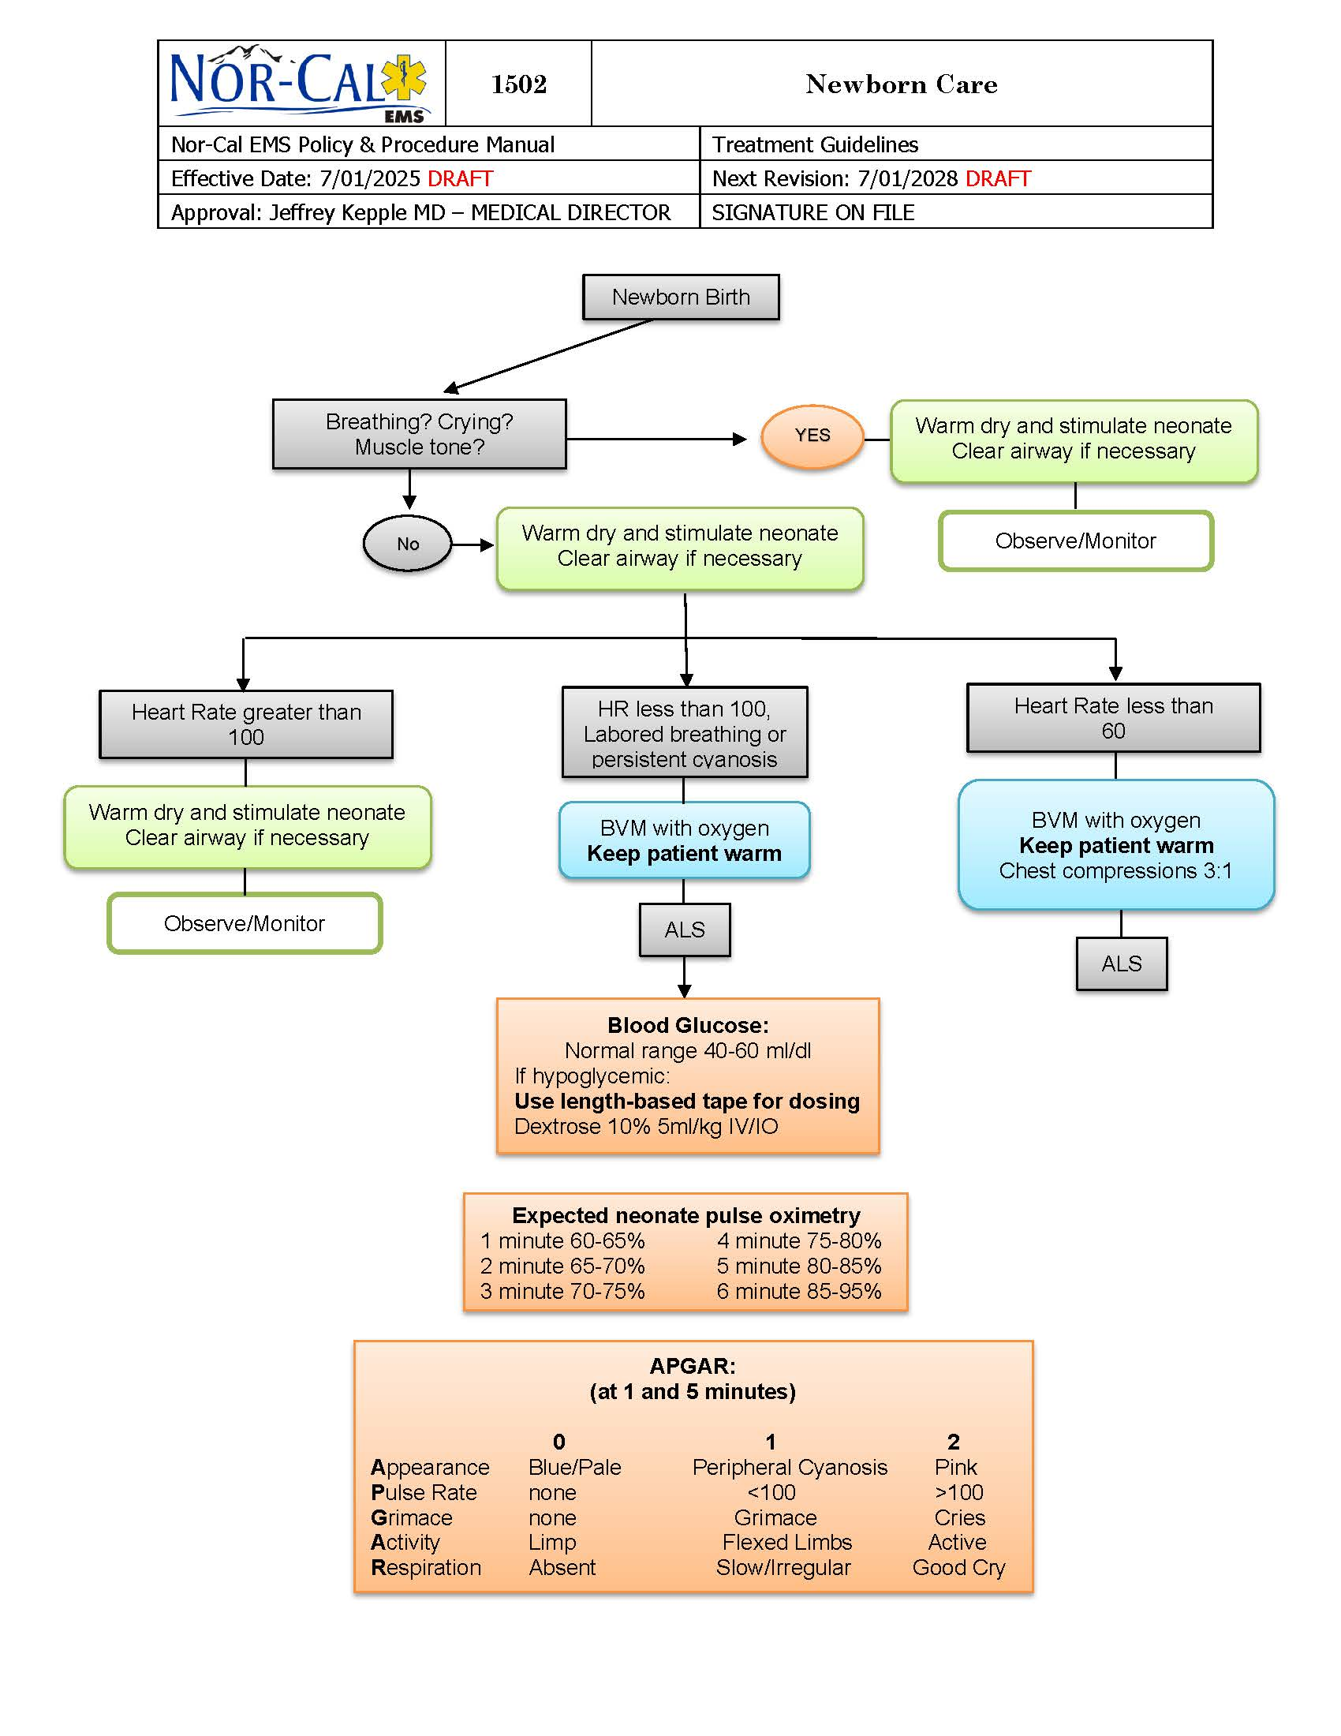
Newborn Care

Slide 12
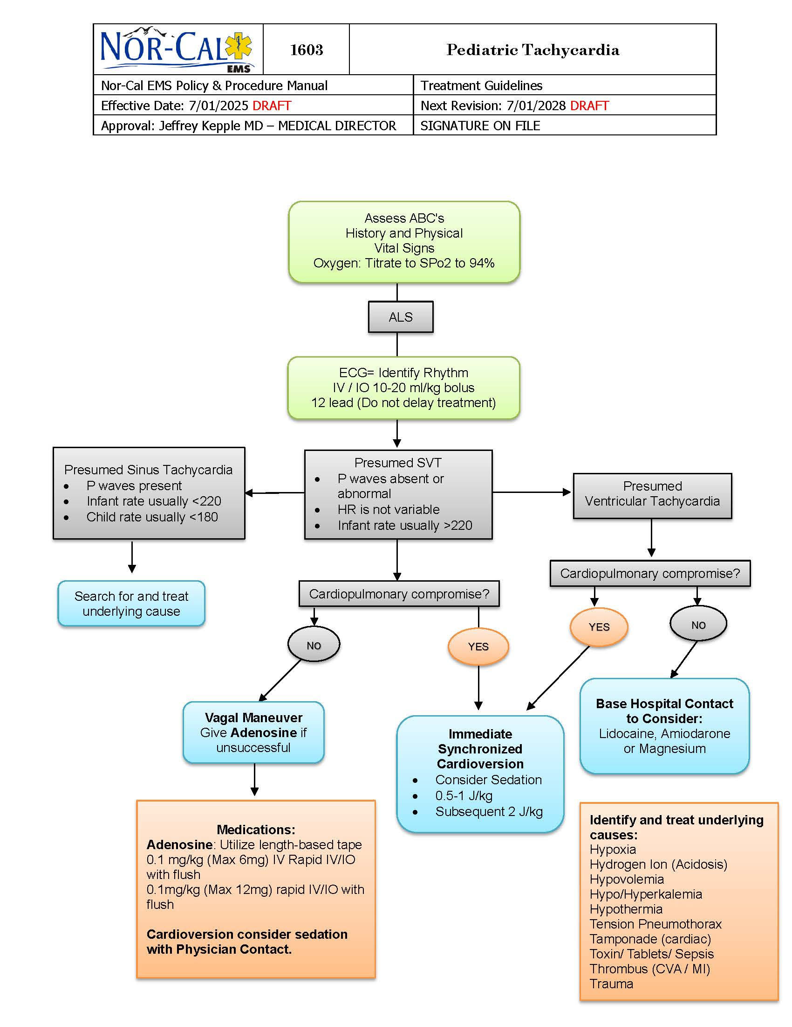
Pediatric Tachycardia

Slide 13
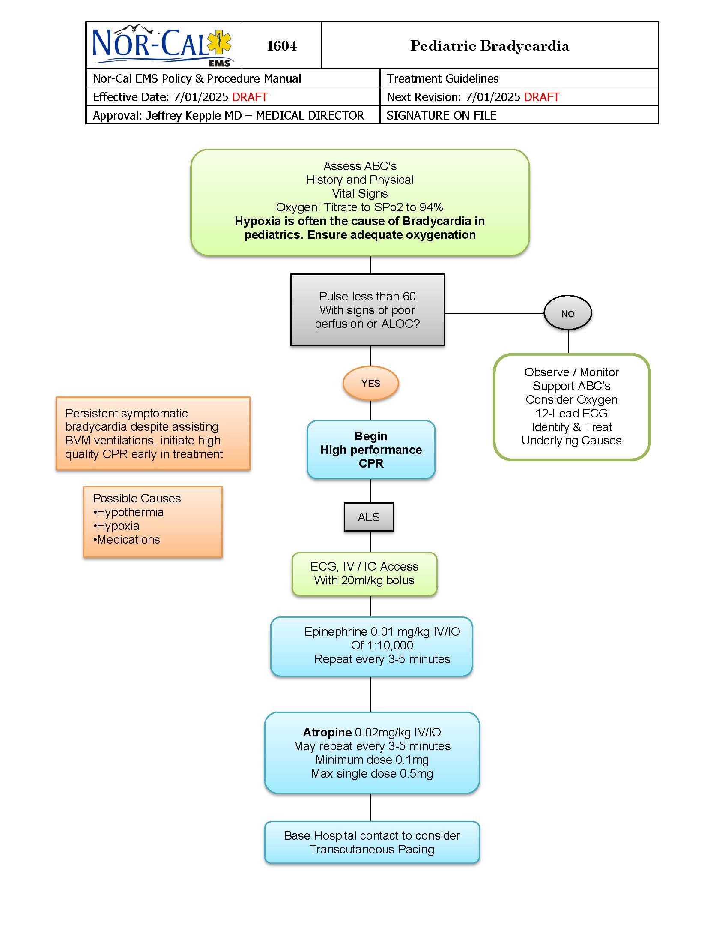
Pediatric Bradycardia

Slide 14
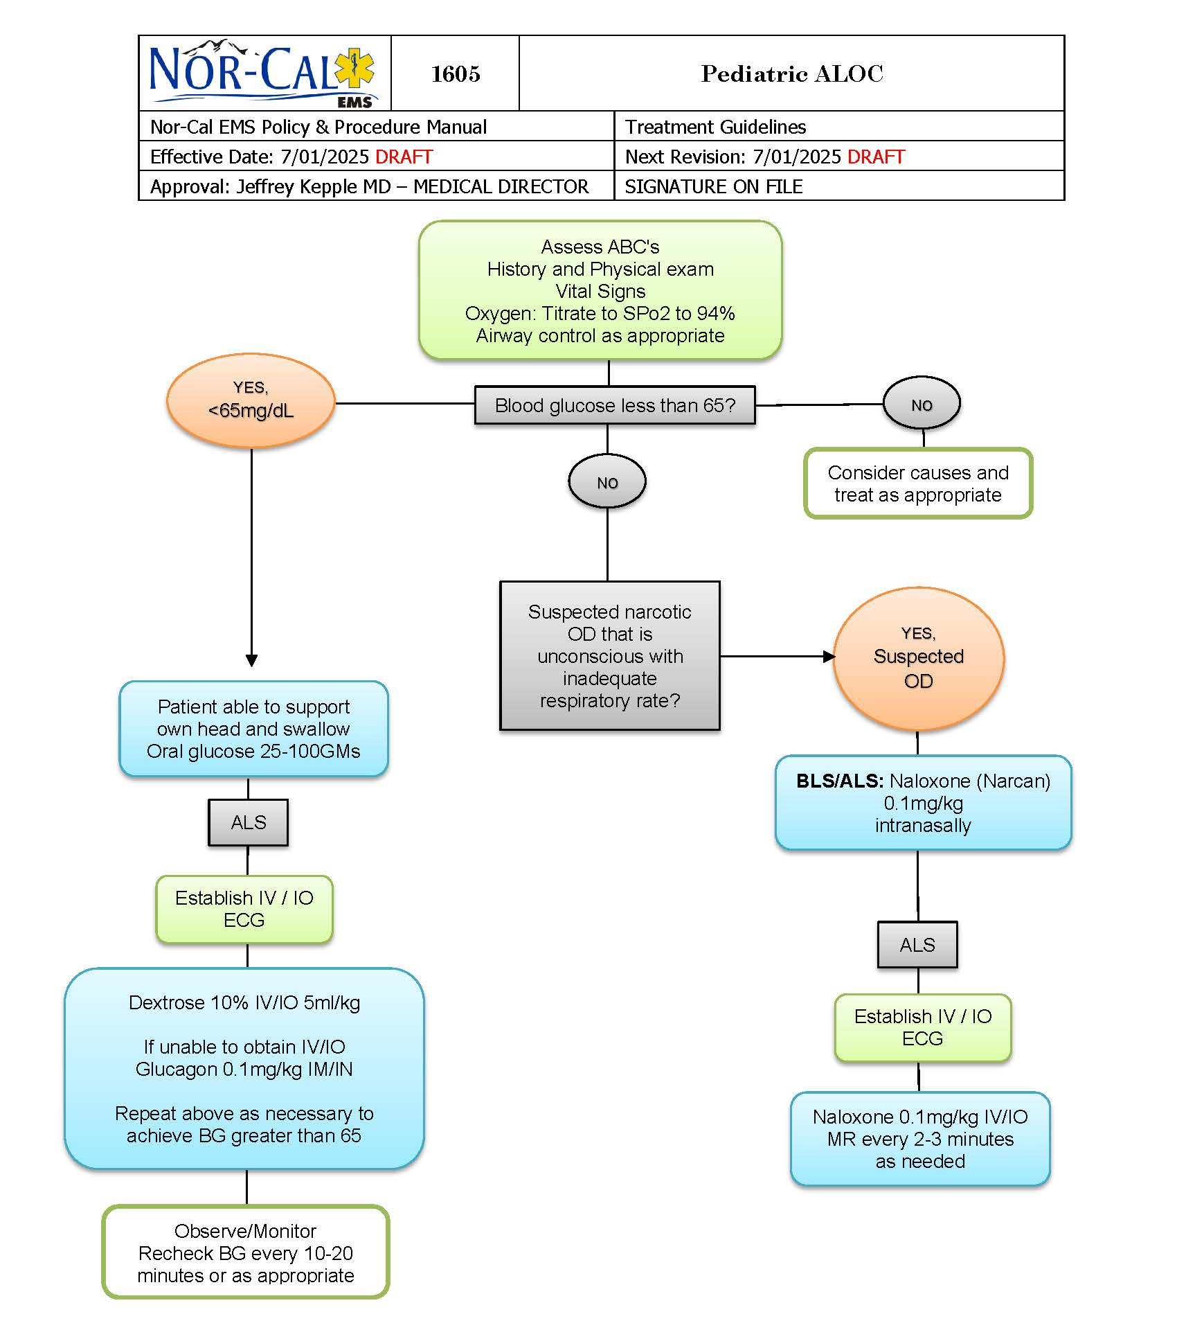
Pediatric ALOC

Slide 15
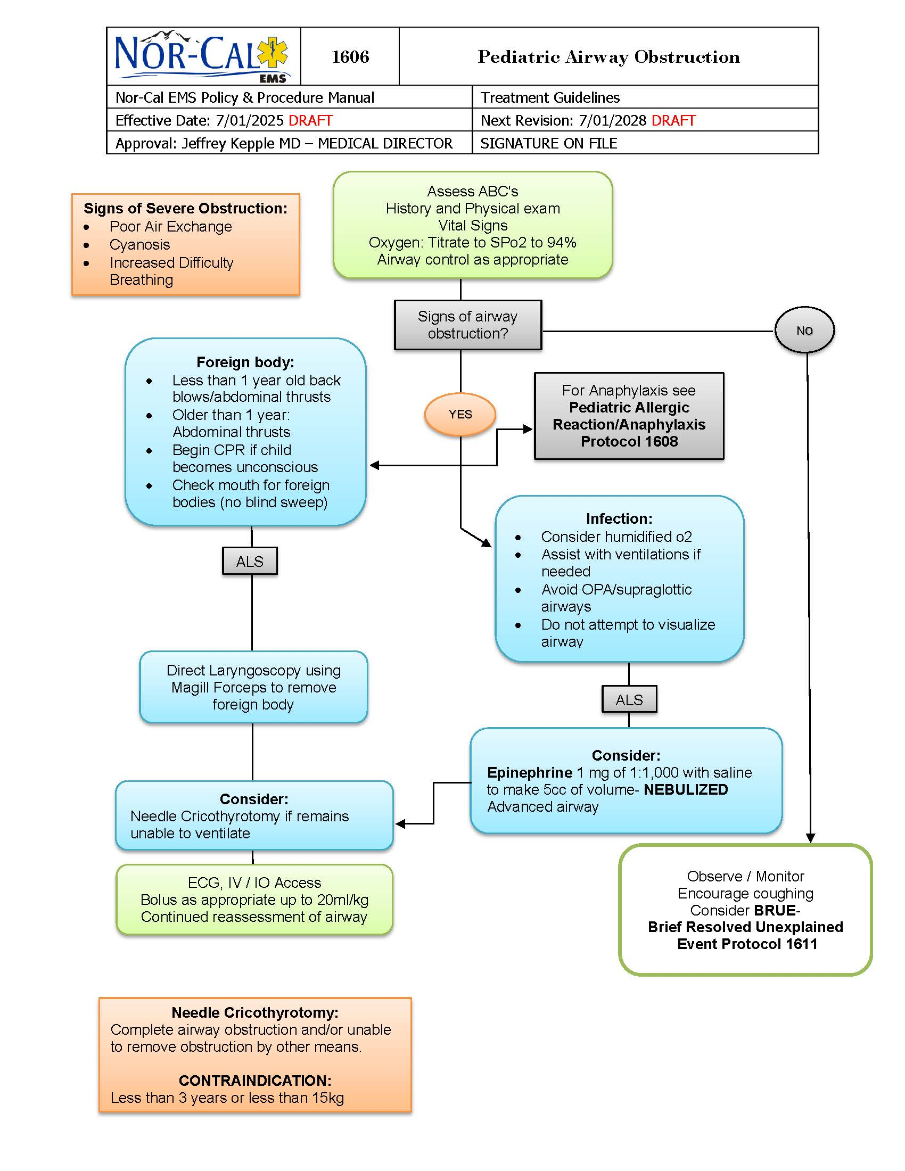
Pediatric Airway Obstruction

Slide 16
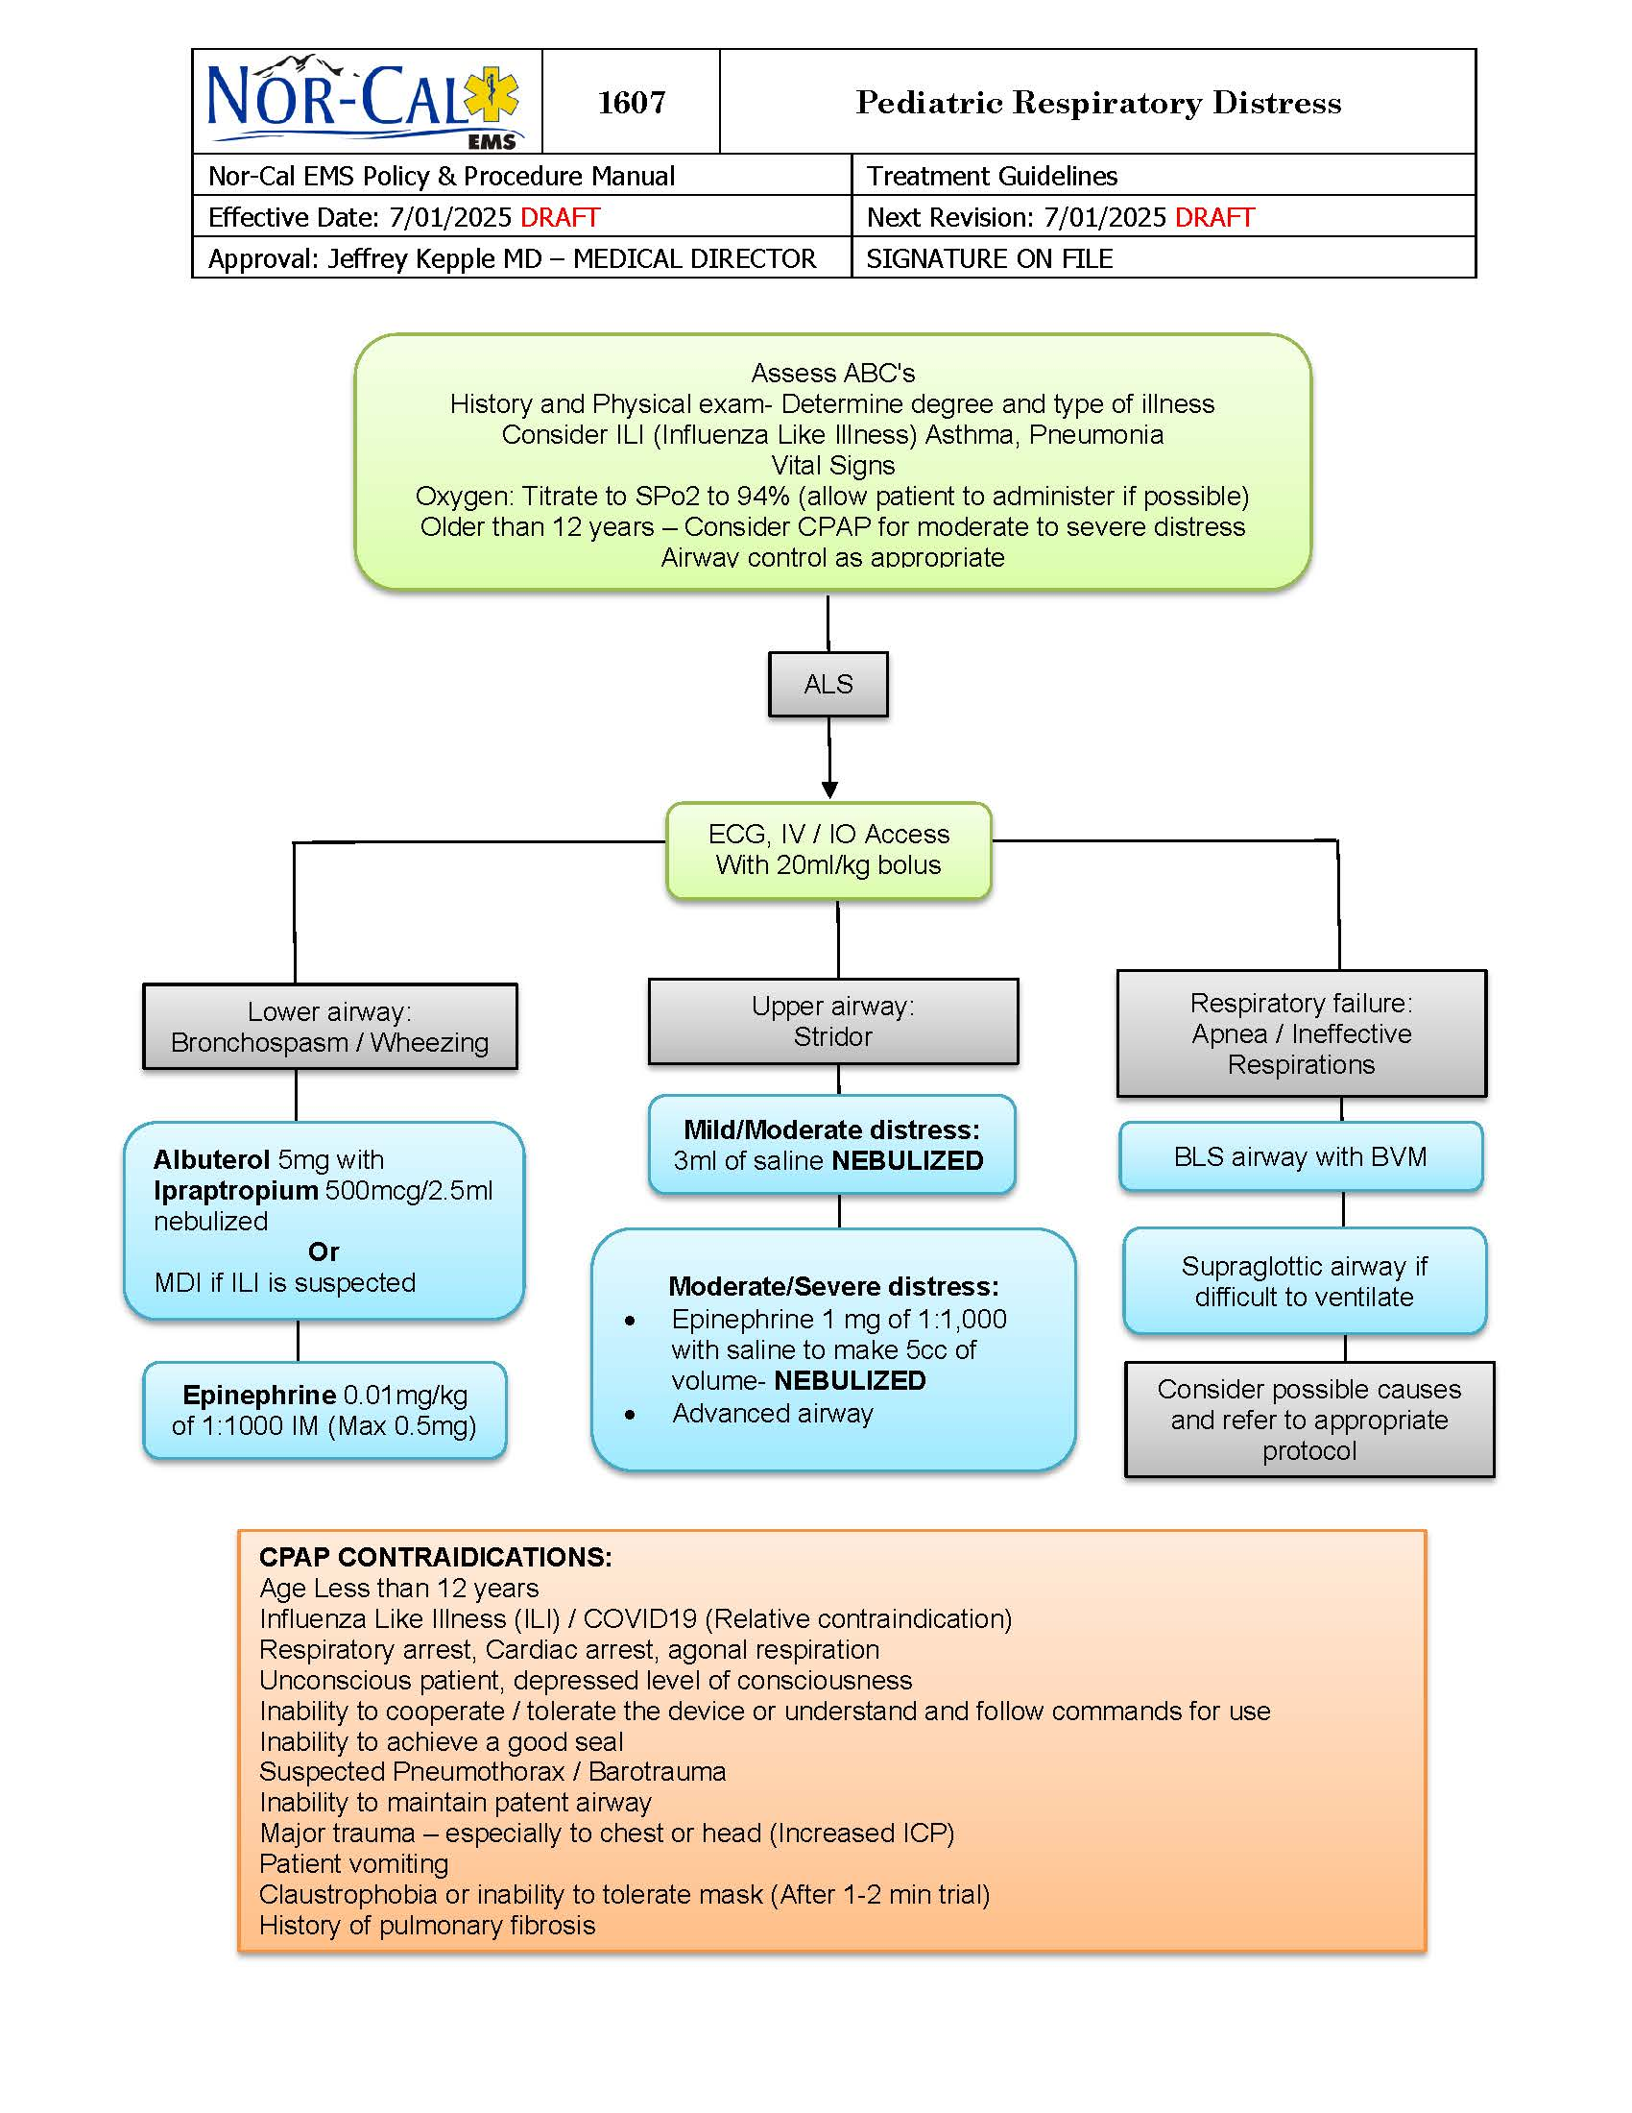
Pediatric Respiratory Distress

Slide 17
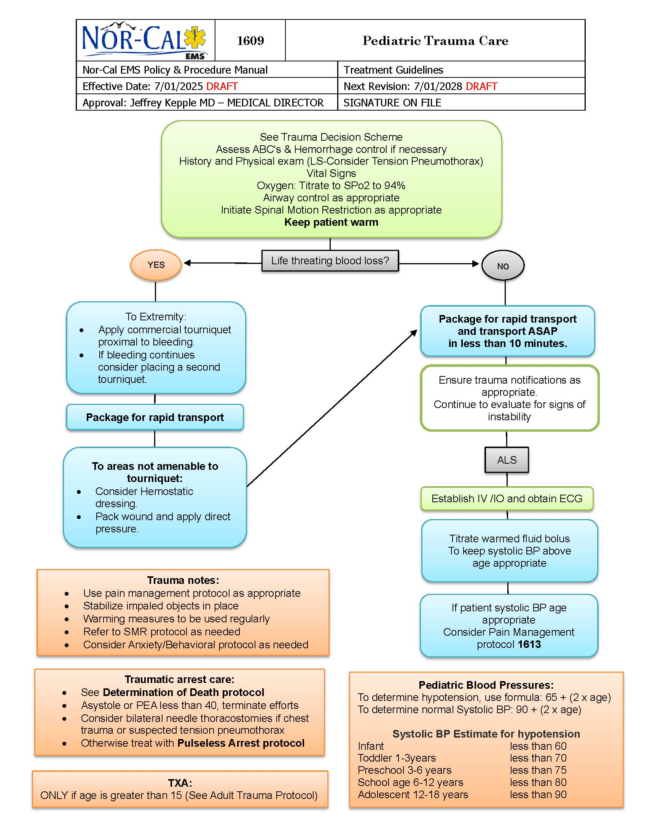
Pediatric Trauma Care

Slide 18
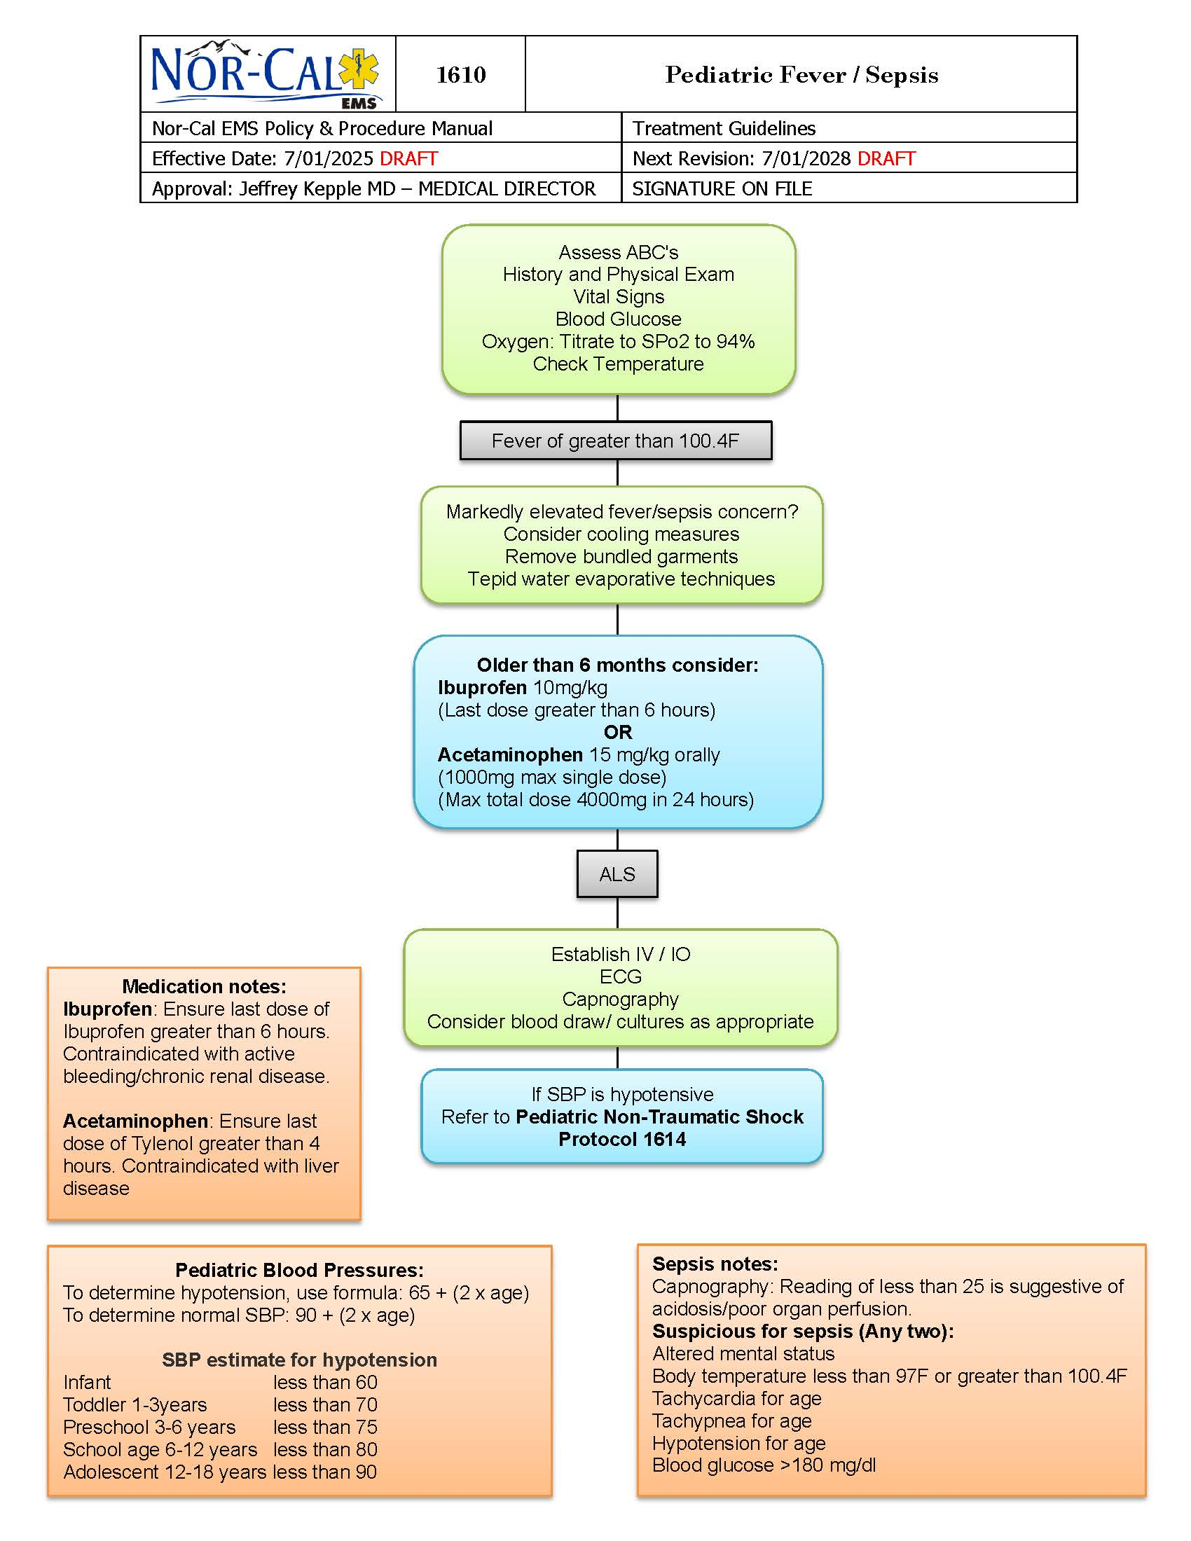
Pediatric Fever/Sepsis

Slide 19
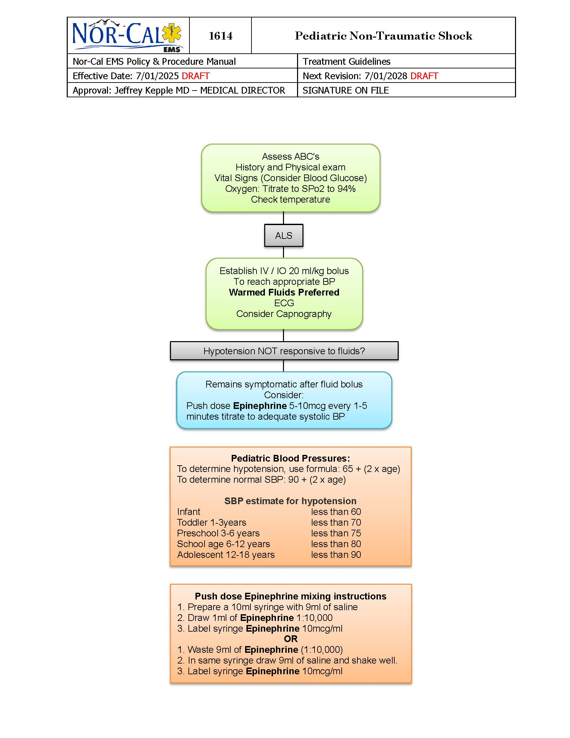
Pediatric Non-Traumatic Shock

Slide 20
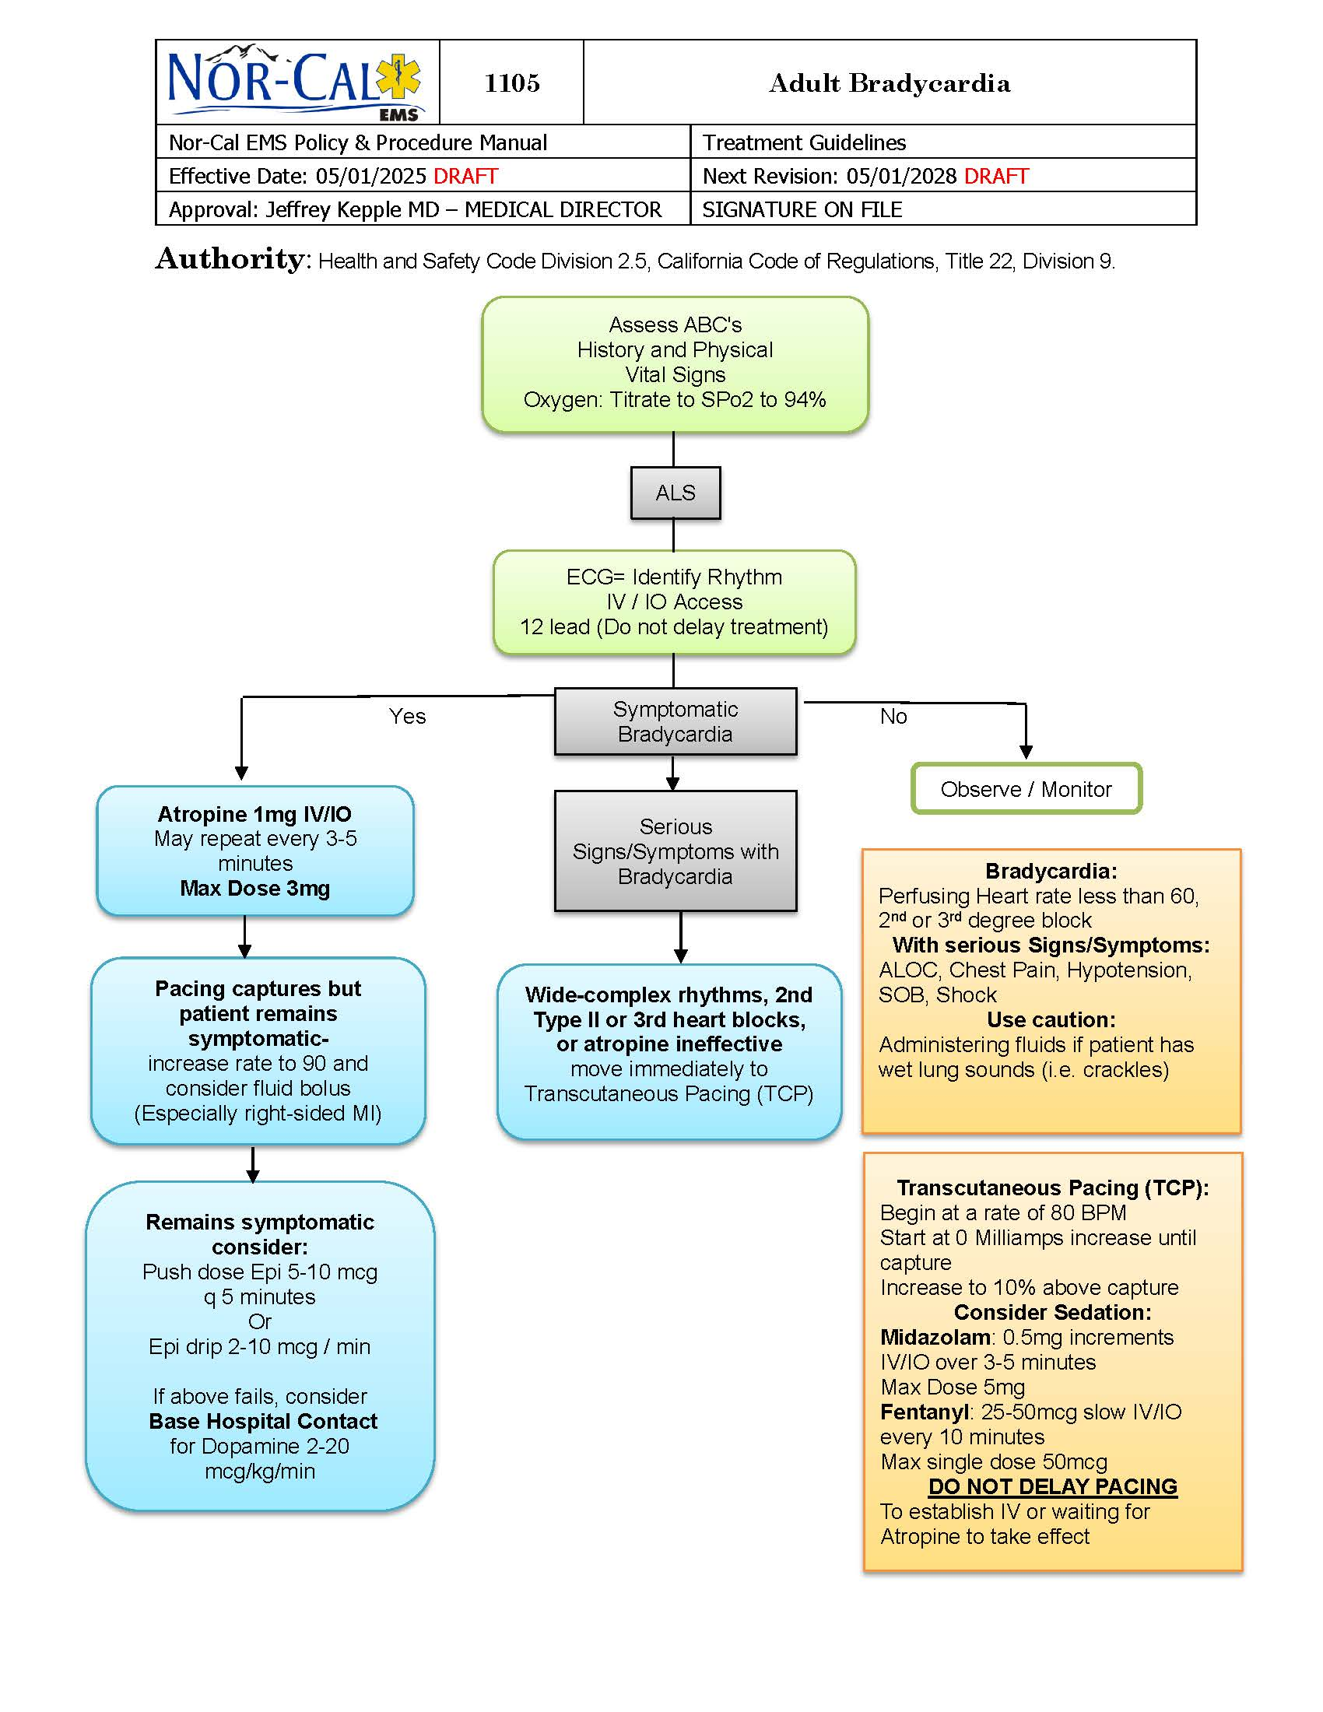
Adult Bradycardia

Slide 21
PROVIDER UPDATES

Slide 22
NOR-CAL EMS UPDATES

Slide 23
OPEN DISCUSSION

Slide 24
RUN REVIEW

Slide 25
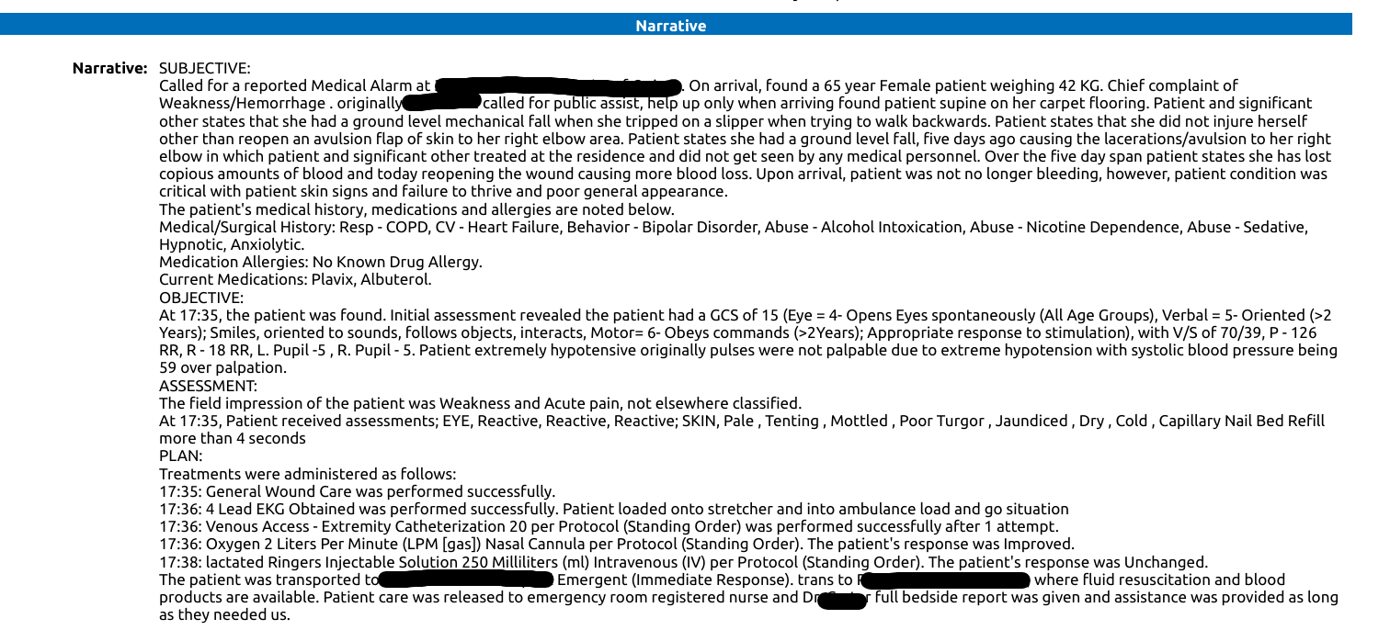

Slide 26
Important Information:
Dispatched Code 2, Public Assist
Pt is a 65YOF, 42kg (92lbs)
Mechanical fall 5 days earlier, no previous care for injuries
Avulsion to RT arm, multiple issues with bleeding control over the 5 days leading up to calling EMS
Medications: Plavix, Albuterol
PMHx: Alcoholism, Bipolar, Heart Failure, COPD, & other Substance Abuse Issues

Slide 27
Pertinent Assessment Findings:
VS: BP 59/P; HR 126; RR 18; SpO2 @ 87% on RA
Initially no detectable pulses
Skin: Pale, tenting, mottled, poor turgor, dry, cold
Cap refill more than 4 seconds
Unknown estimated blood loss; currently no active bleeding

Slide 28
Initial Treatments:
IV with 20 g. TVI 250mL
Oxygen @ 2lpm NC
ECG
Blood Glucose @ 110mg/dL

Slide 29
Any other treatments to consider?
Scene to ED: 2-minute transport

Slide 30
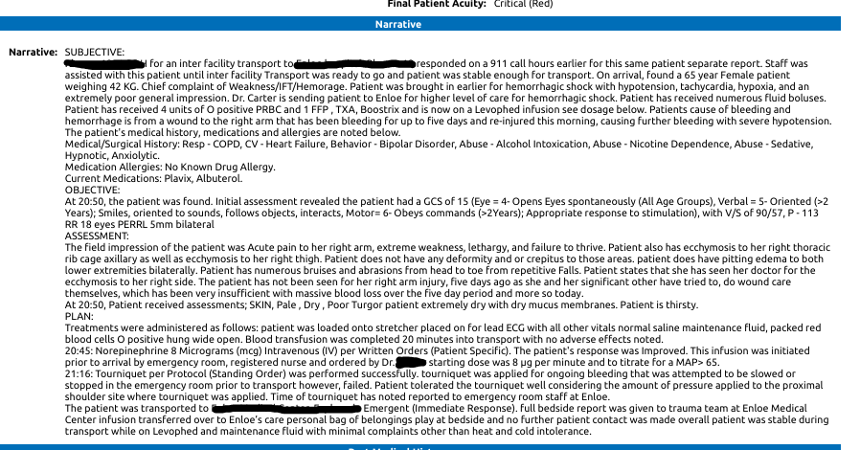

Slide 31
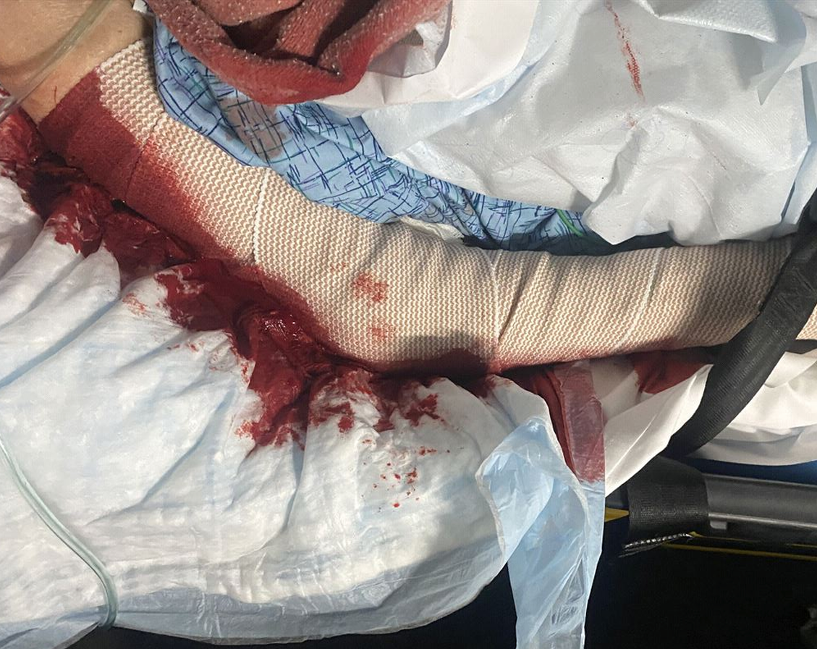

Slide 32
Now what?
Same patient, now being sent to a higher level of care by ground ambulance
Blood transfusion with Packed RBCs @ ED
Norepinephrine administered @ ED
Tourniquet applied during Interfacility Transport for recurrent bleeding (2116)

Slide 33
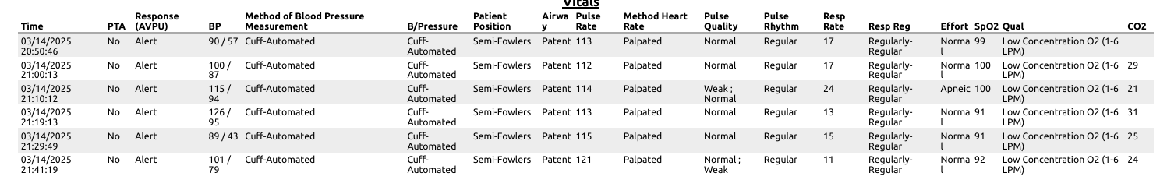
More VS

Slide 34
Outcome? Questions? Discussion?

Slide 35
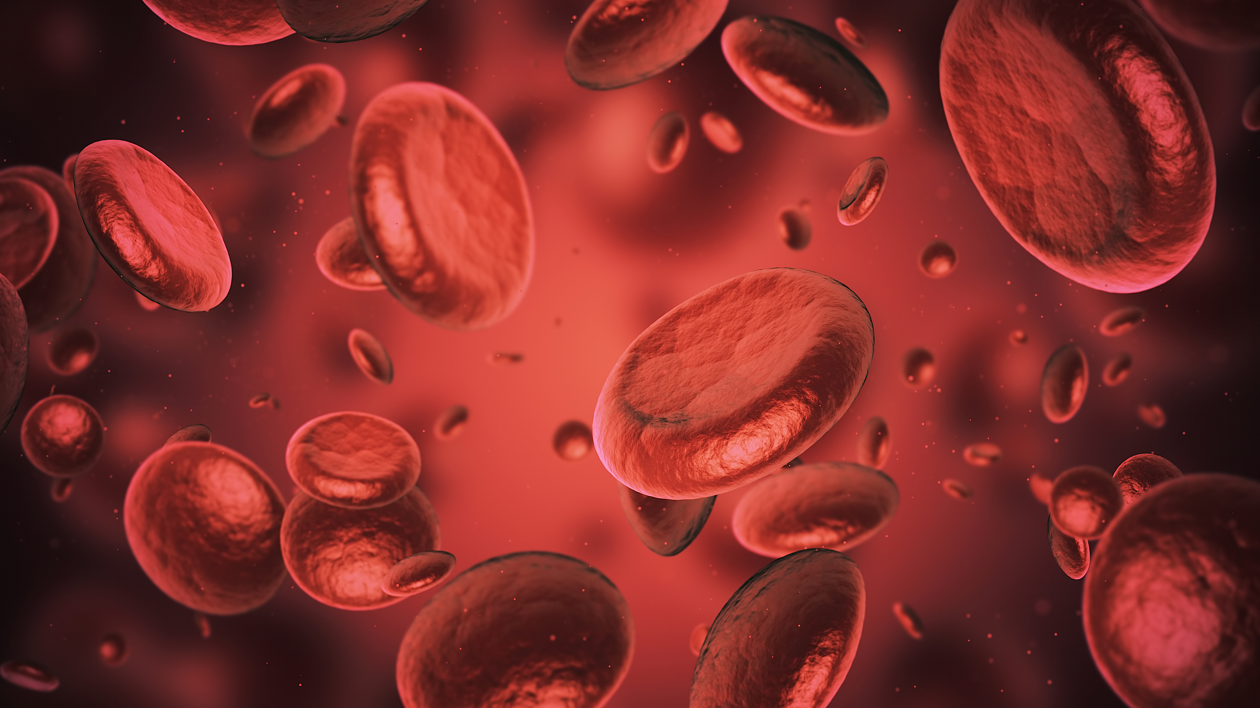
All about the blood....
The average human adult has approximately 5 Liters of blood, this is roughly 7% of their overall body weight.
60,000 Americans die each year from uncontrolled bleeding (1.5 million deaths/year worldwide).
Type O- is considered the universal blood donor type
You can lose approximately 1 Liter of blood without harm.
The human body produces 2 million red blood cells every second.
Someone needs blood in the United States every 2 seconds.

Slide 36
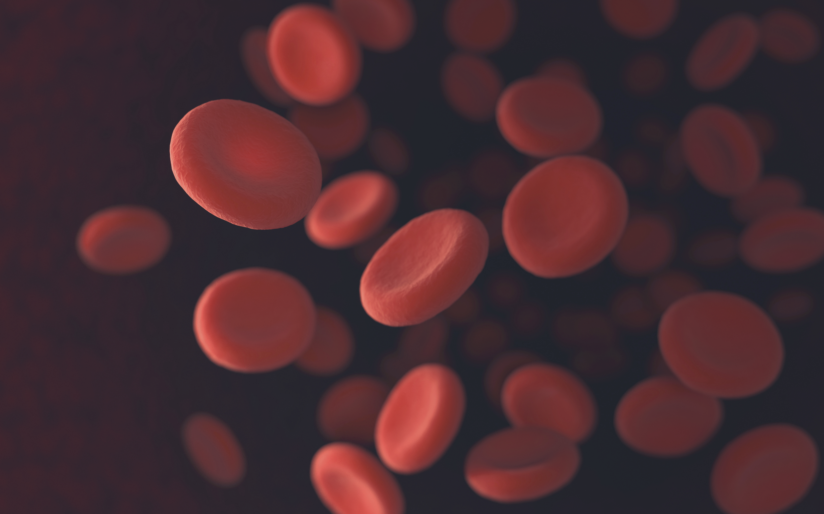
Please Donate!
In January 2024, the Red Cross announced an emergency blood shortage nationwide
On June 4, 2025, New York Blood Donation announced a critical shortage.
Only 3% of the population donates blood (that # decreased during COVID)
Studies show that donating blood regularly can improve heart health and lower blood pressure
1 donation can save 3 lives!

Slide 37
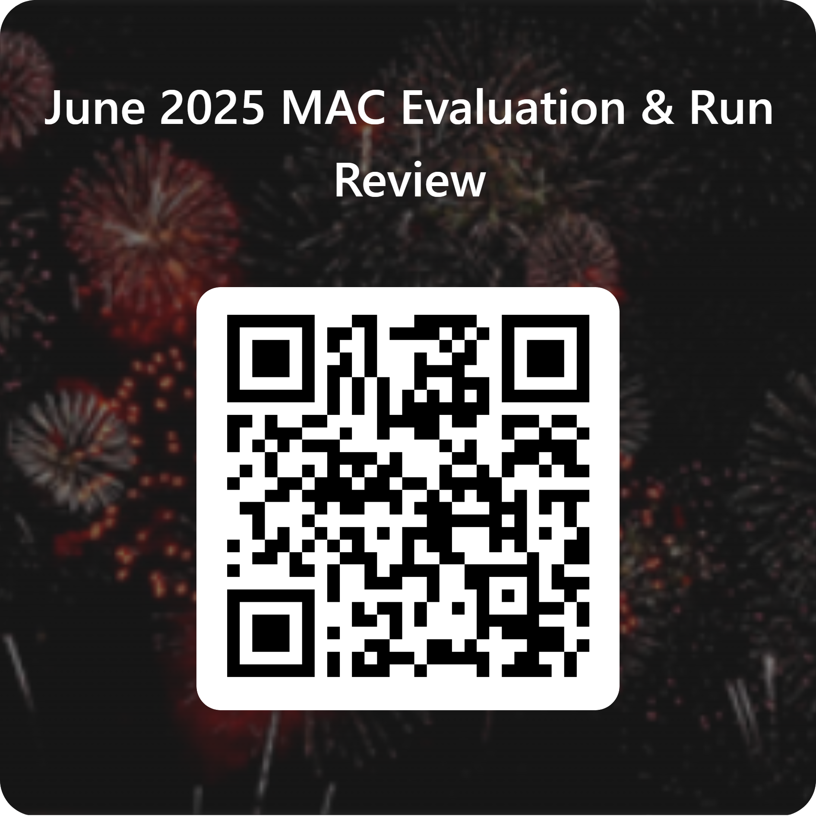
Steps to get CEU:
Use QR code to submit evaluation & test
Include Name & Certification #
Use the email you want your CEU’s sent to
Each Run Review will be worth one (1) CEU Hour
Link to get CEUs will be open for 2 weeks following the completion of the MAC Meeting. If you miss the 2-week deadline, you will not be eligible to receive the CEU for that meeting.
Sign roster (in chat or in person), complete evaluation form and test to be eligible for CEU’s

Slide 38
MEETING SCHEDULE:
August 13, 2025
October 8, 2025
1000-1200
December 10, 2025

Slide 39
Thank you for attending!

