Slide 1

Medical Advisory Committee

Slide 2
Meeting Information
Zoom ID:
823 0170 1195
Passcode:
065384
*Please turn on cameras during meeting*
In person attendance available at the following location for February 2025:
Nor-Cal EMS:
Redding Office

Slide 3
Agenda
Welcome and Introductions
Completed & Approved Policy Revisions
Current Policy & Treatment Guidelines Updates & Discussion
Provider Updates
Nor-Cal EMS Updates
Changes to Inspection Scheduling for ALS/BLS Transport Providers
Open Discussion
Run Review
Steps to get CEU’s
Medical Advisory Committee Information

Slide 4
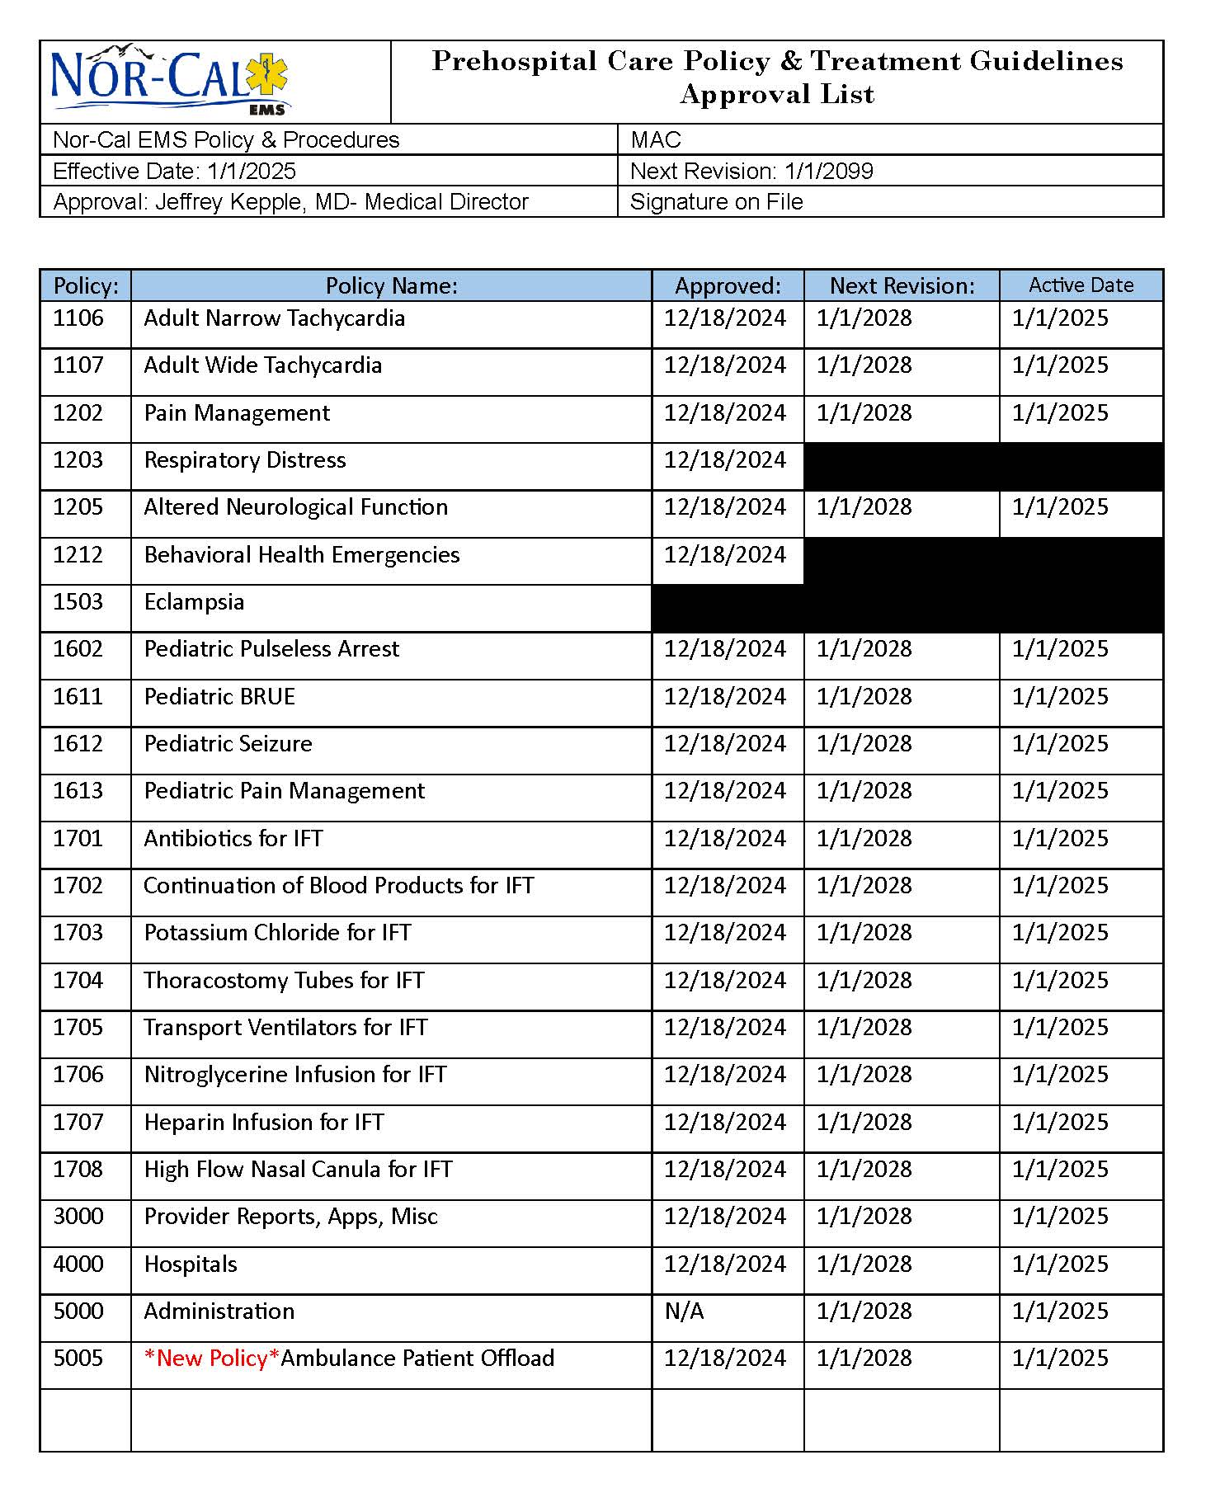
Completed & Approved
Policy and Treatment Guideline Revisions

Slide 5
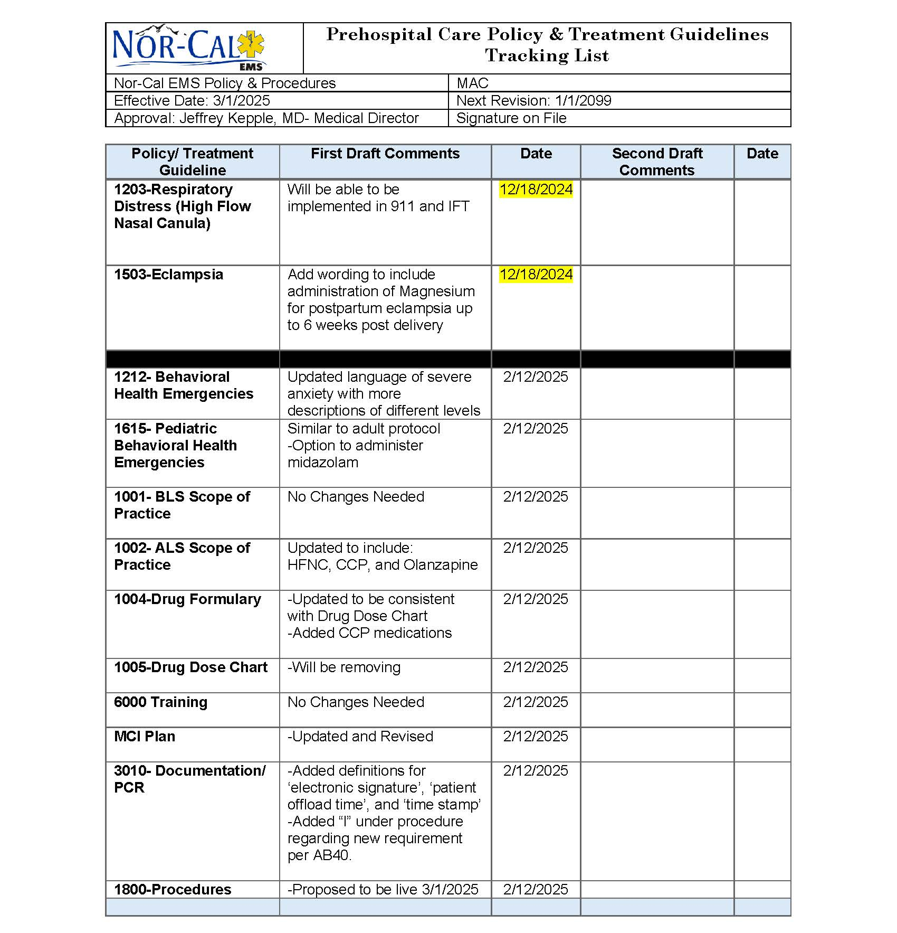
Current Policy &
Treatment Guidelines Updates
& Discussion

Slide 6
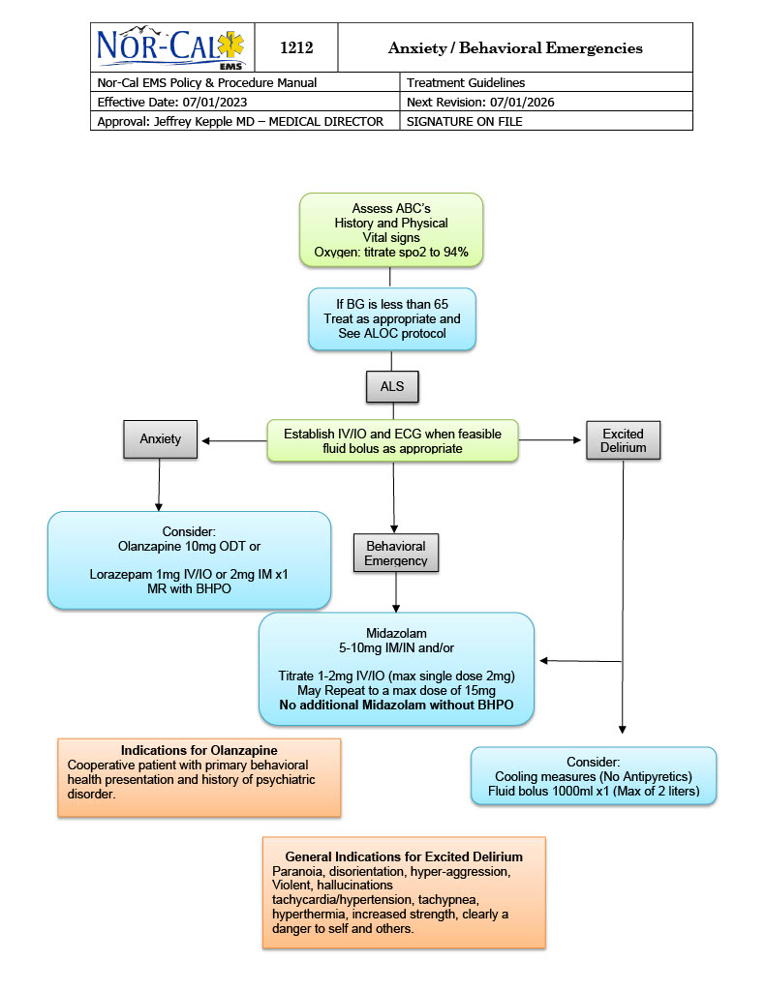
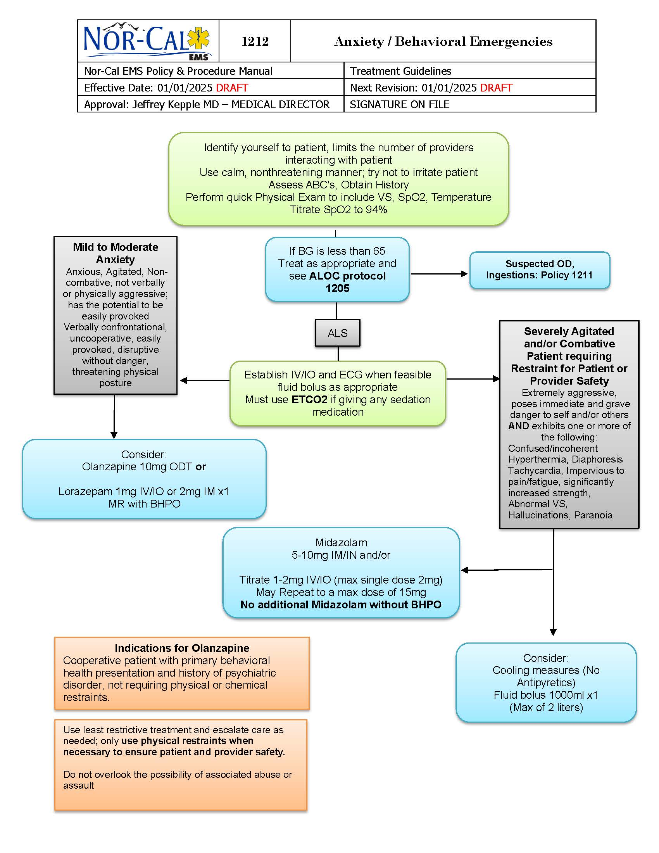
CURRENT
PROPOSED
Current
Proposed

Slide 7
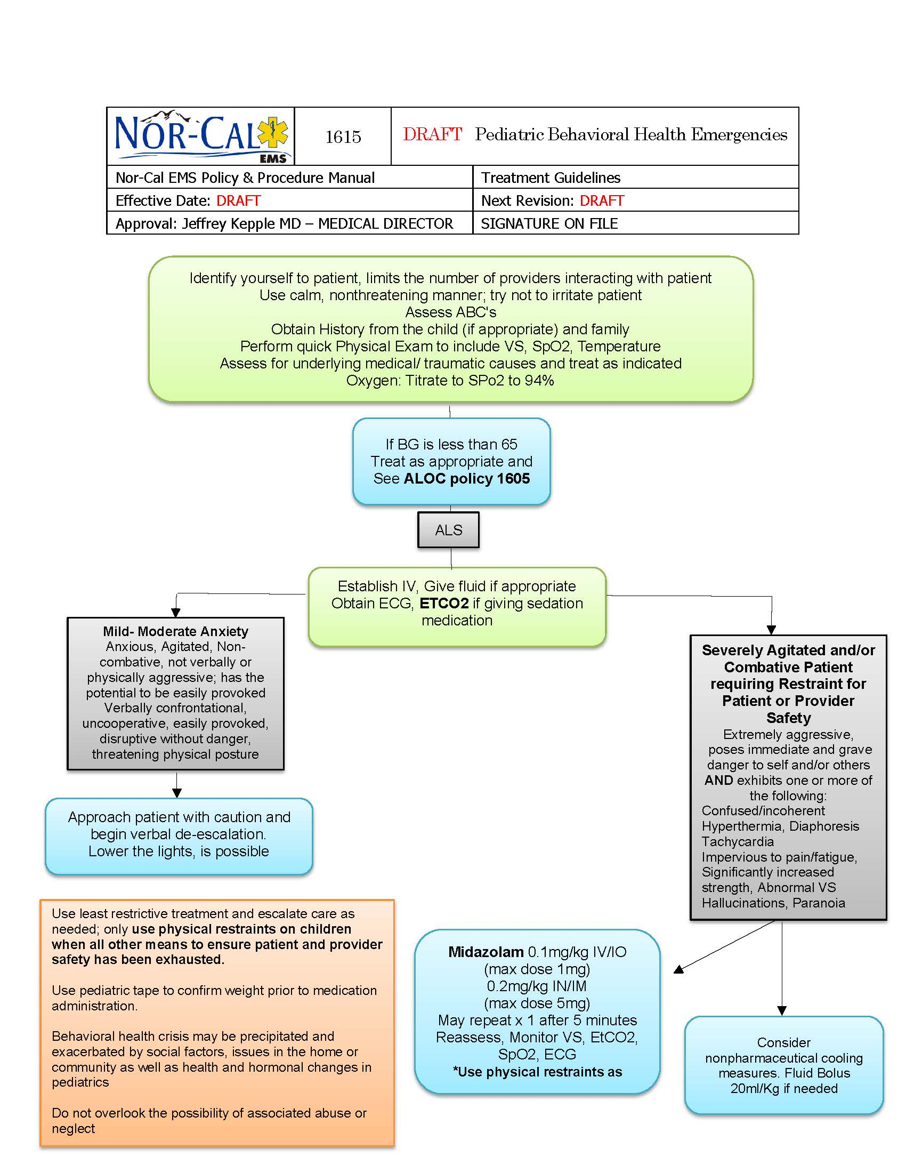
*NEW Treatment Guideline*
Correlates with adult policy
Allows administration of Midazolam when needed for Severely Agitated and/or Combative Patient Requiring Restraint for Patient or Provider Safety
0.1mg/kg IV/IO
0.2mg/kg IN/IM
Use physical restraints as last resort

Slide 8
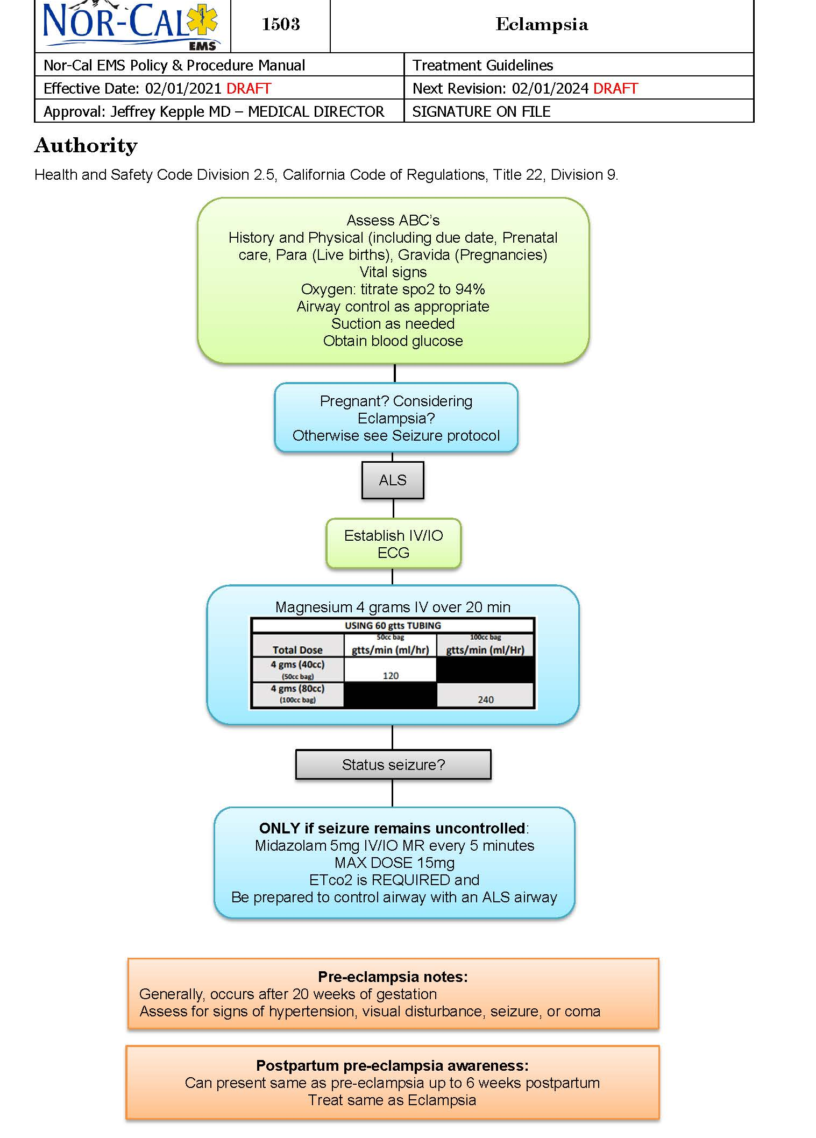
Eclampsia
*Added wording to include administration of Magnesium for postpartum eclampsia up to 6 weeks post delivery

Slide 9
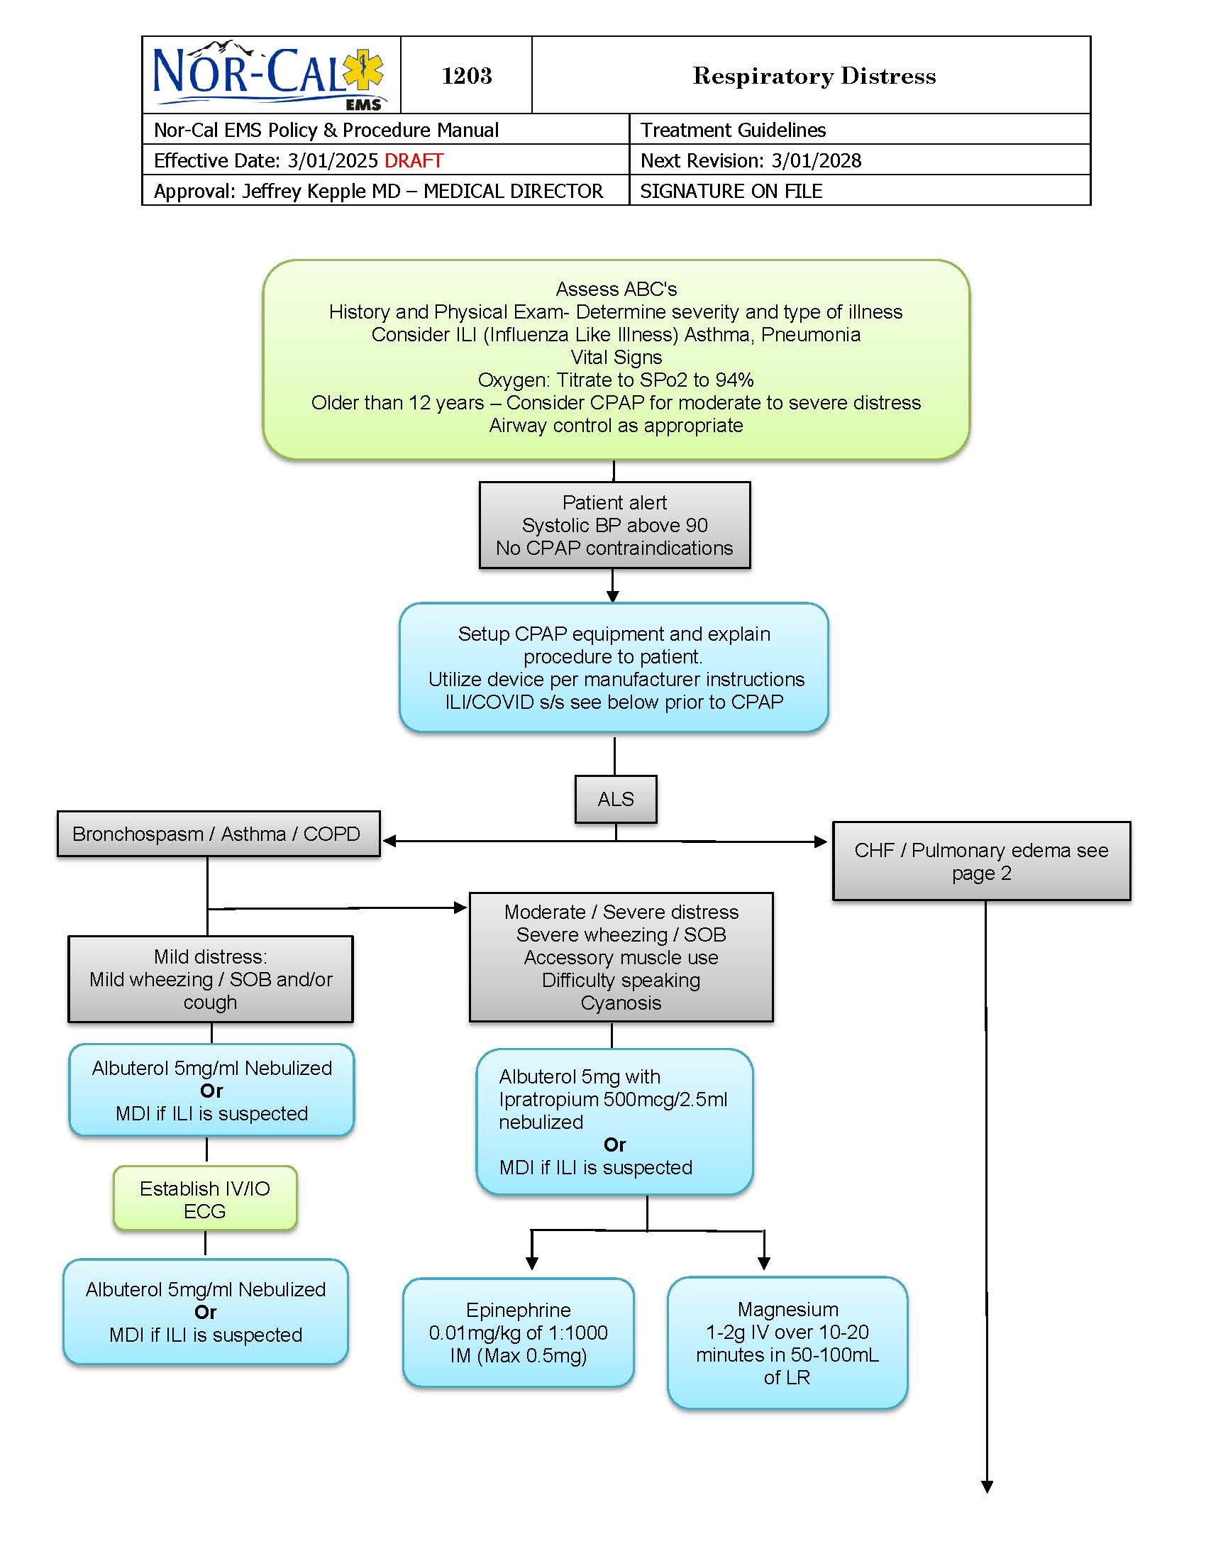
1203- Respiratory Distress
(Page 1)
*Addition of Magnesium
1-2mg over 5-10 minutes in 50-100mL of LR

Slide 10
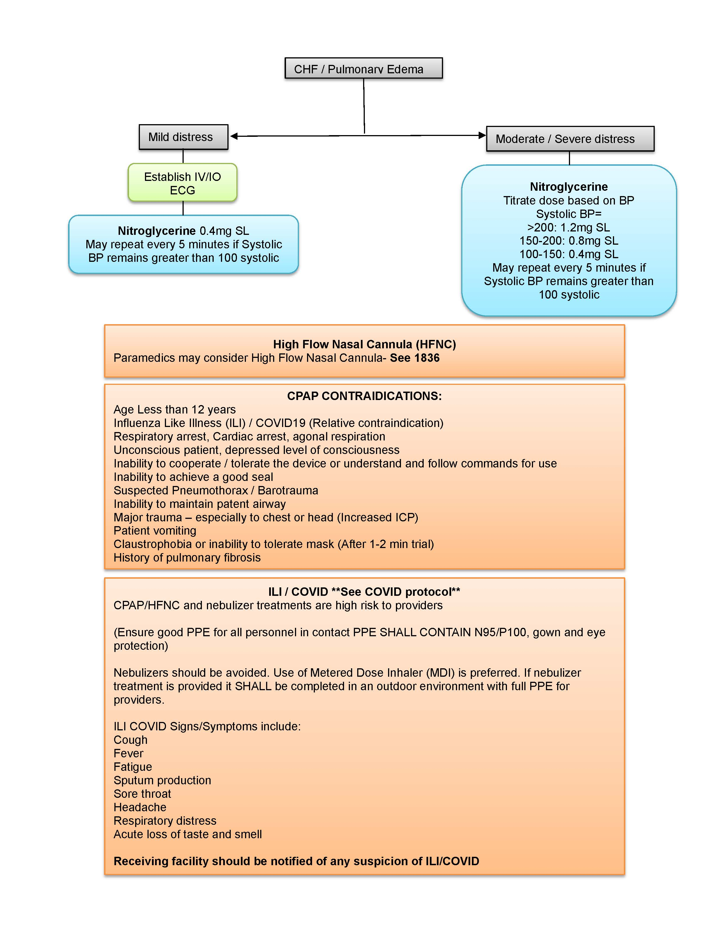
High Flow Nasal Canula
*Will be implemented in
911 and IFT
1203-Respiratory Distress
(Page 2)
1708-Interfacility Transfer High Flow Nasal Canula
(Released 1/1/2025)
1836-Procedure

Slide 11
1004- Drug Formulary
Updated to match Drug Dosing Chart
Updated contraindications, indications, formatting inconsistencies, etc.
Added CCP Medications/Parameters
1001-BLS Scope of Practice
No Changes
1005- Drug Dose Chart
Will be removing
Medication/dosing errors
Less information
Potential for errors with multiple databases
If we can improve the formulary, please let us know
1002-ALS Scope of Practice
Added CCP Section
Added HFNC
Added Olanzapine
1000- Scope of Practice

Slide 12


Will be posted by March 1,2025

Slide 13
6000-Training Section
6001 Skills Roster
6002 Course Evaluation
Skill Sheets
EMR
EMT
BLS- 6101 to 6110
ALS- 6301 to 6309
6500 Training
6510, 6520, 6530, 6540, 6550. 6570
Currently no changes

Slide 14
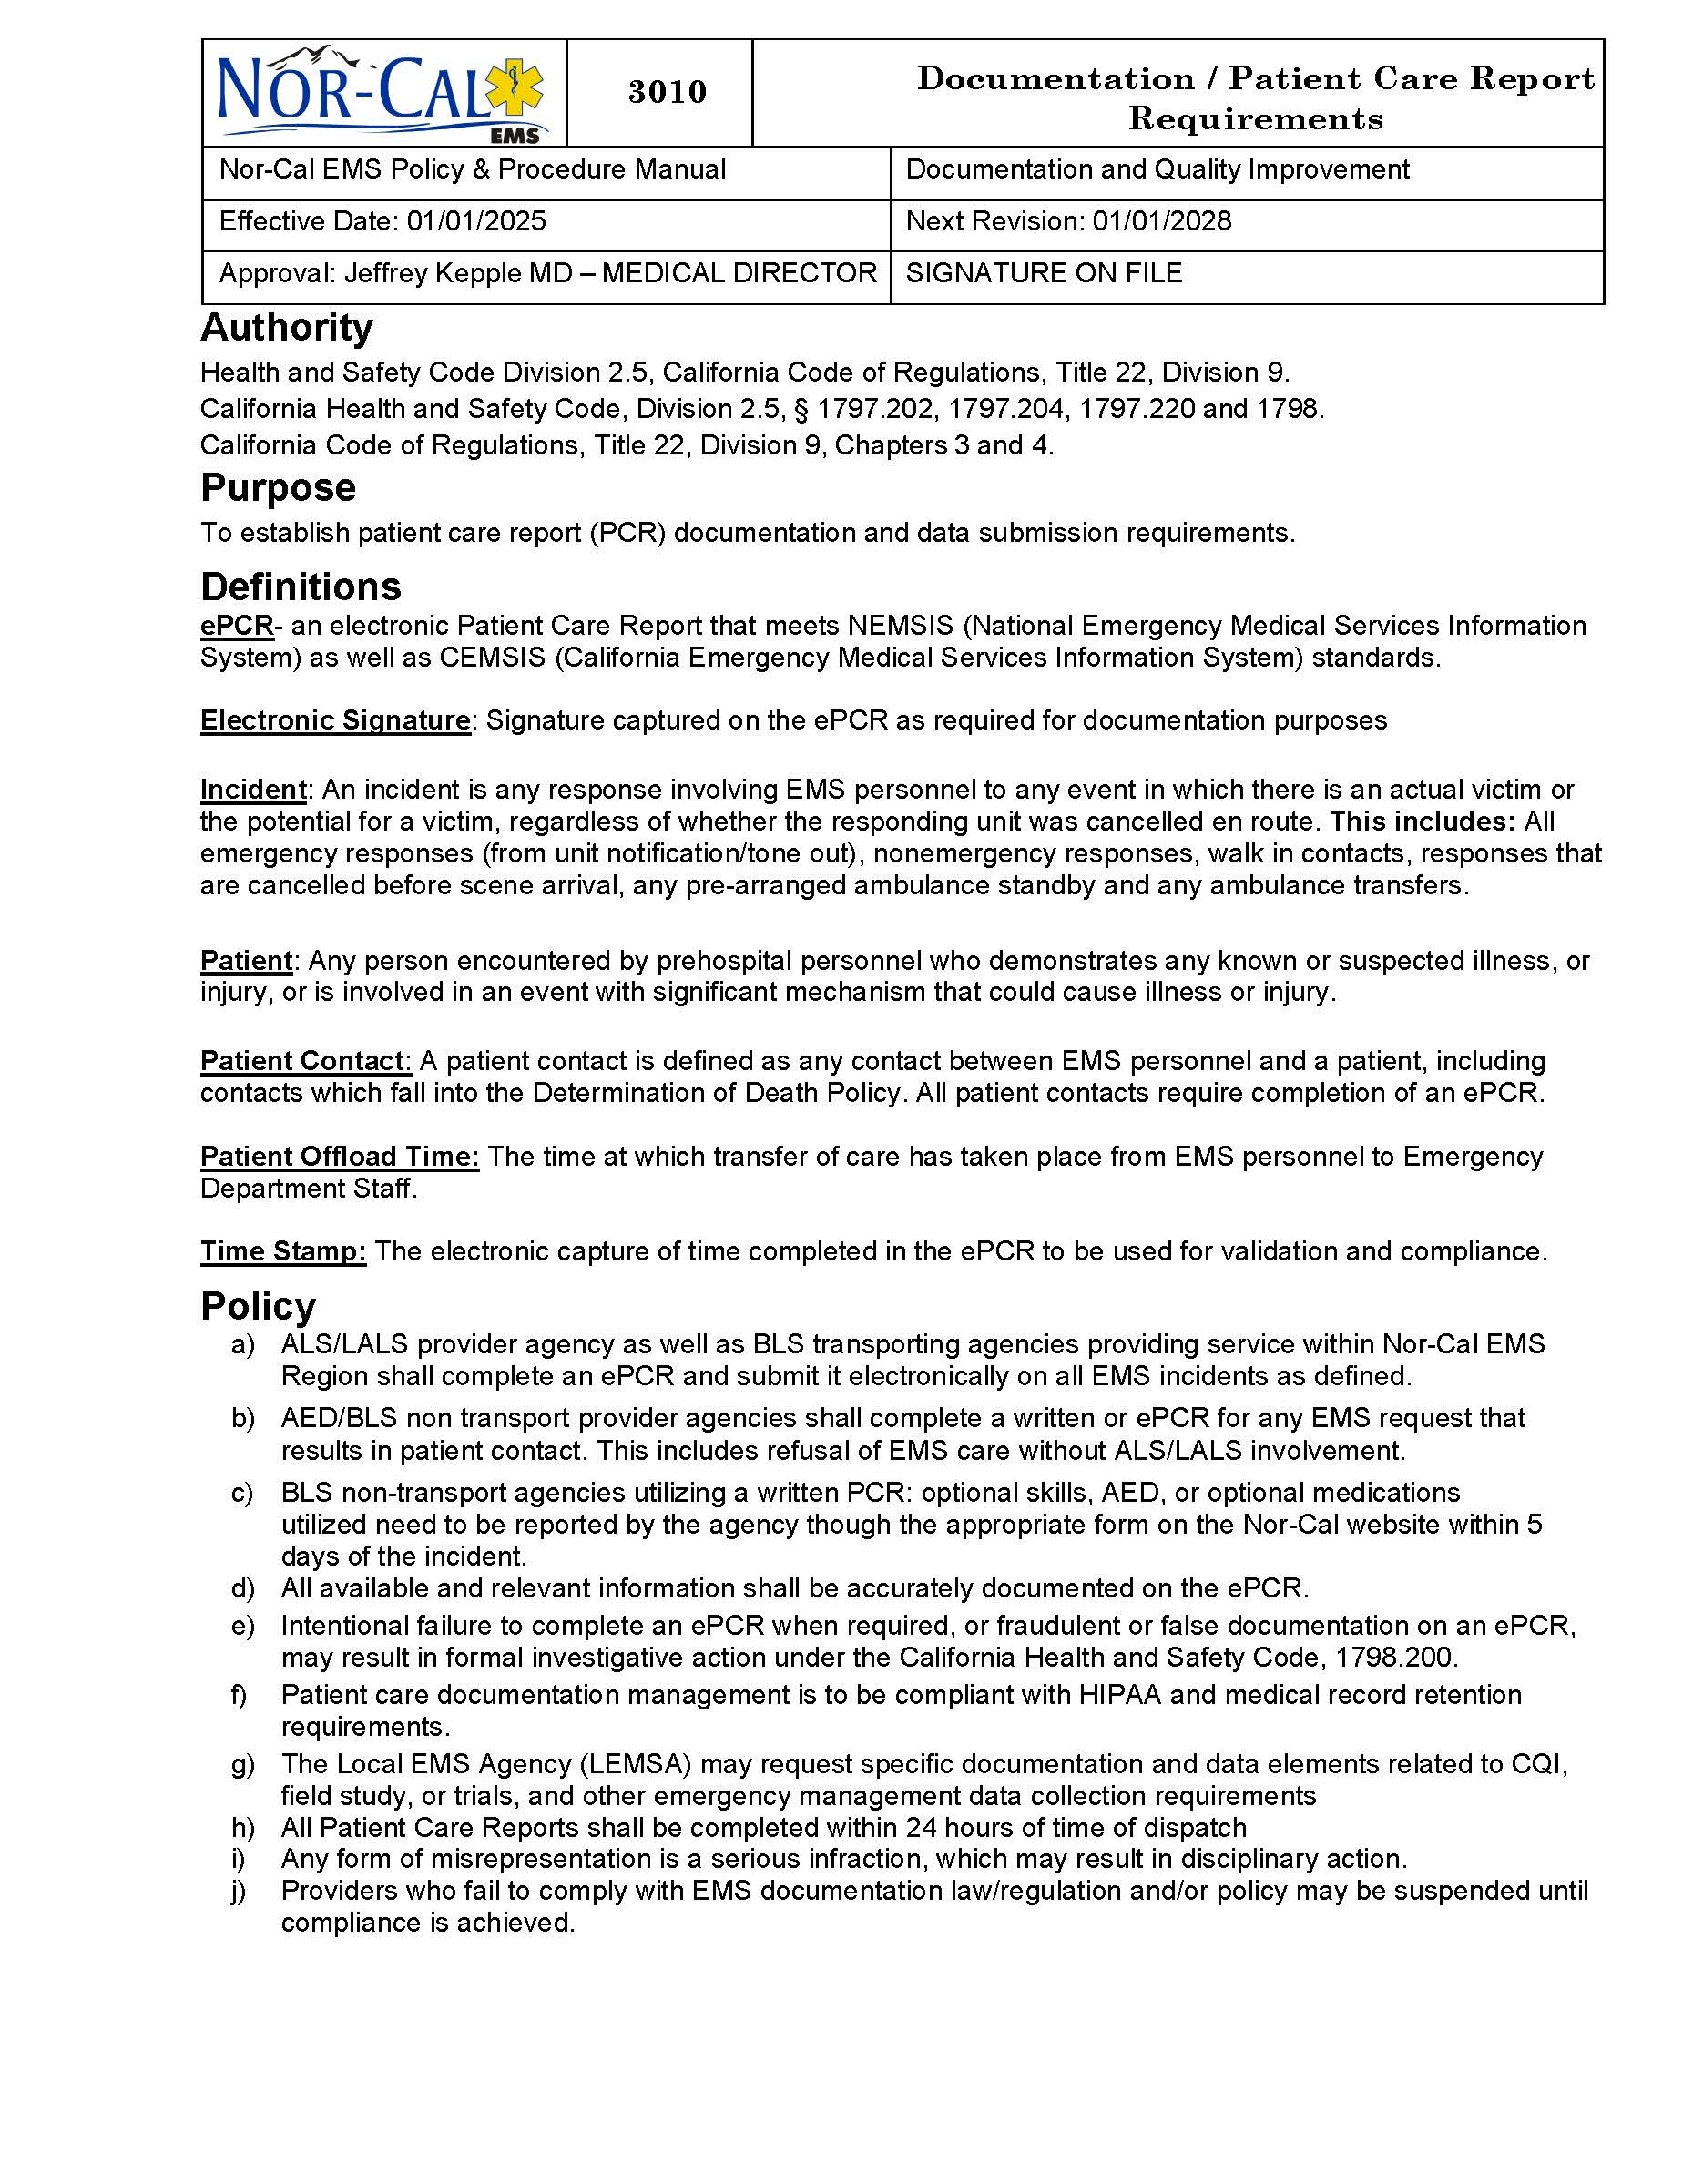
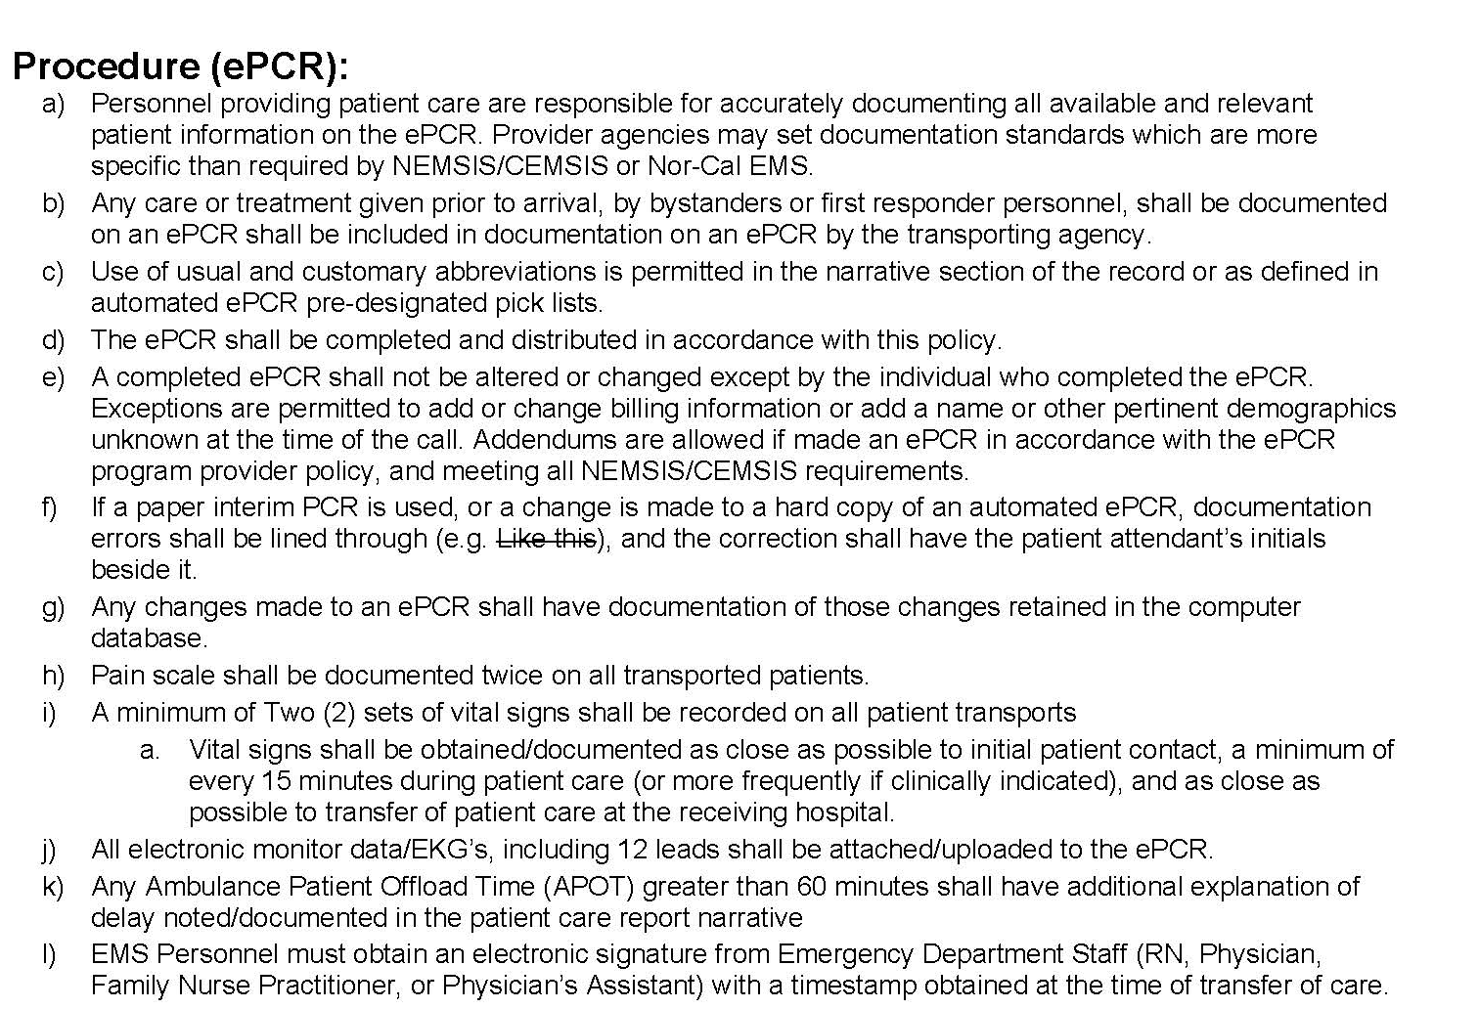



3010- Documentation/ Patient Care Reports
Added definition for ‘Electronic Signature’
Added definition for ‘Patient Offload Time’
Added definition for ‘Time Stamp’
Added “l” under Procedure to include requirement of obtaining an electronic signature at the time of patient transfer.

Slide 15
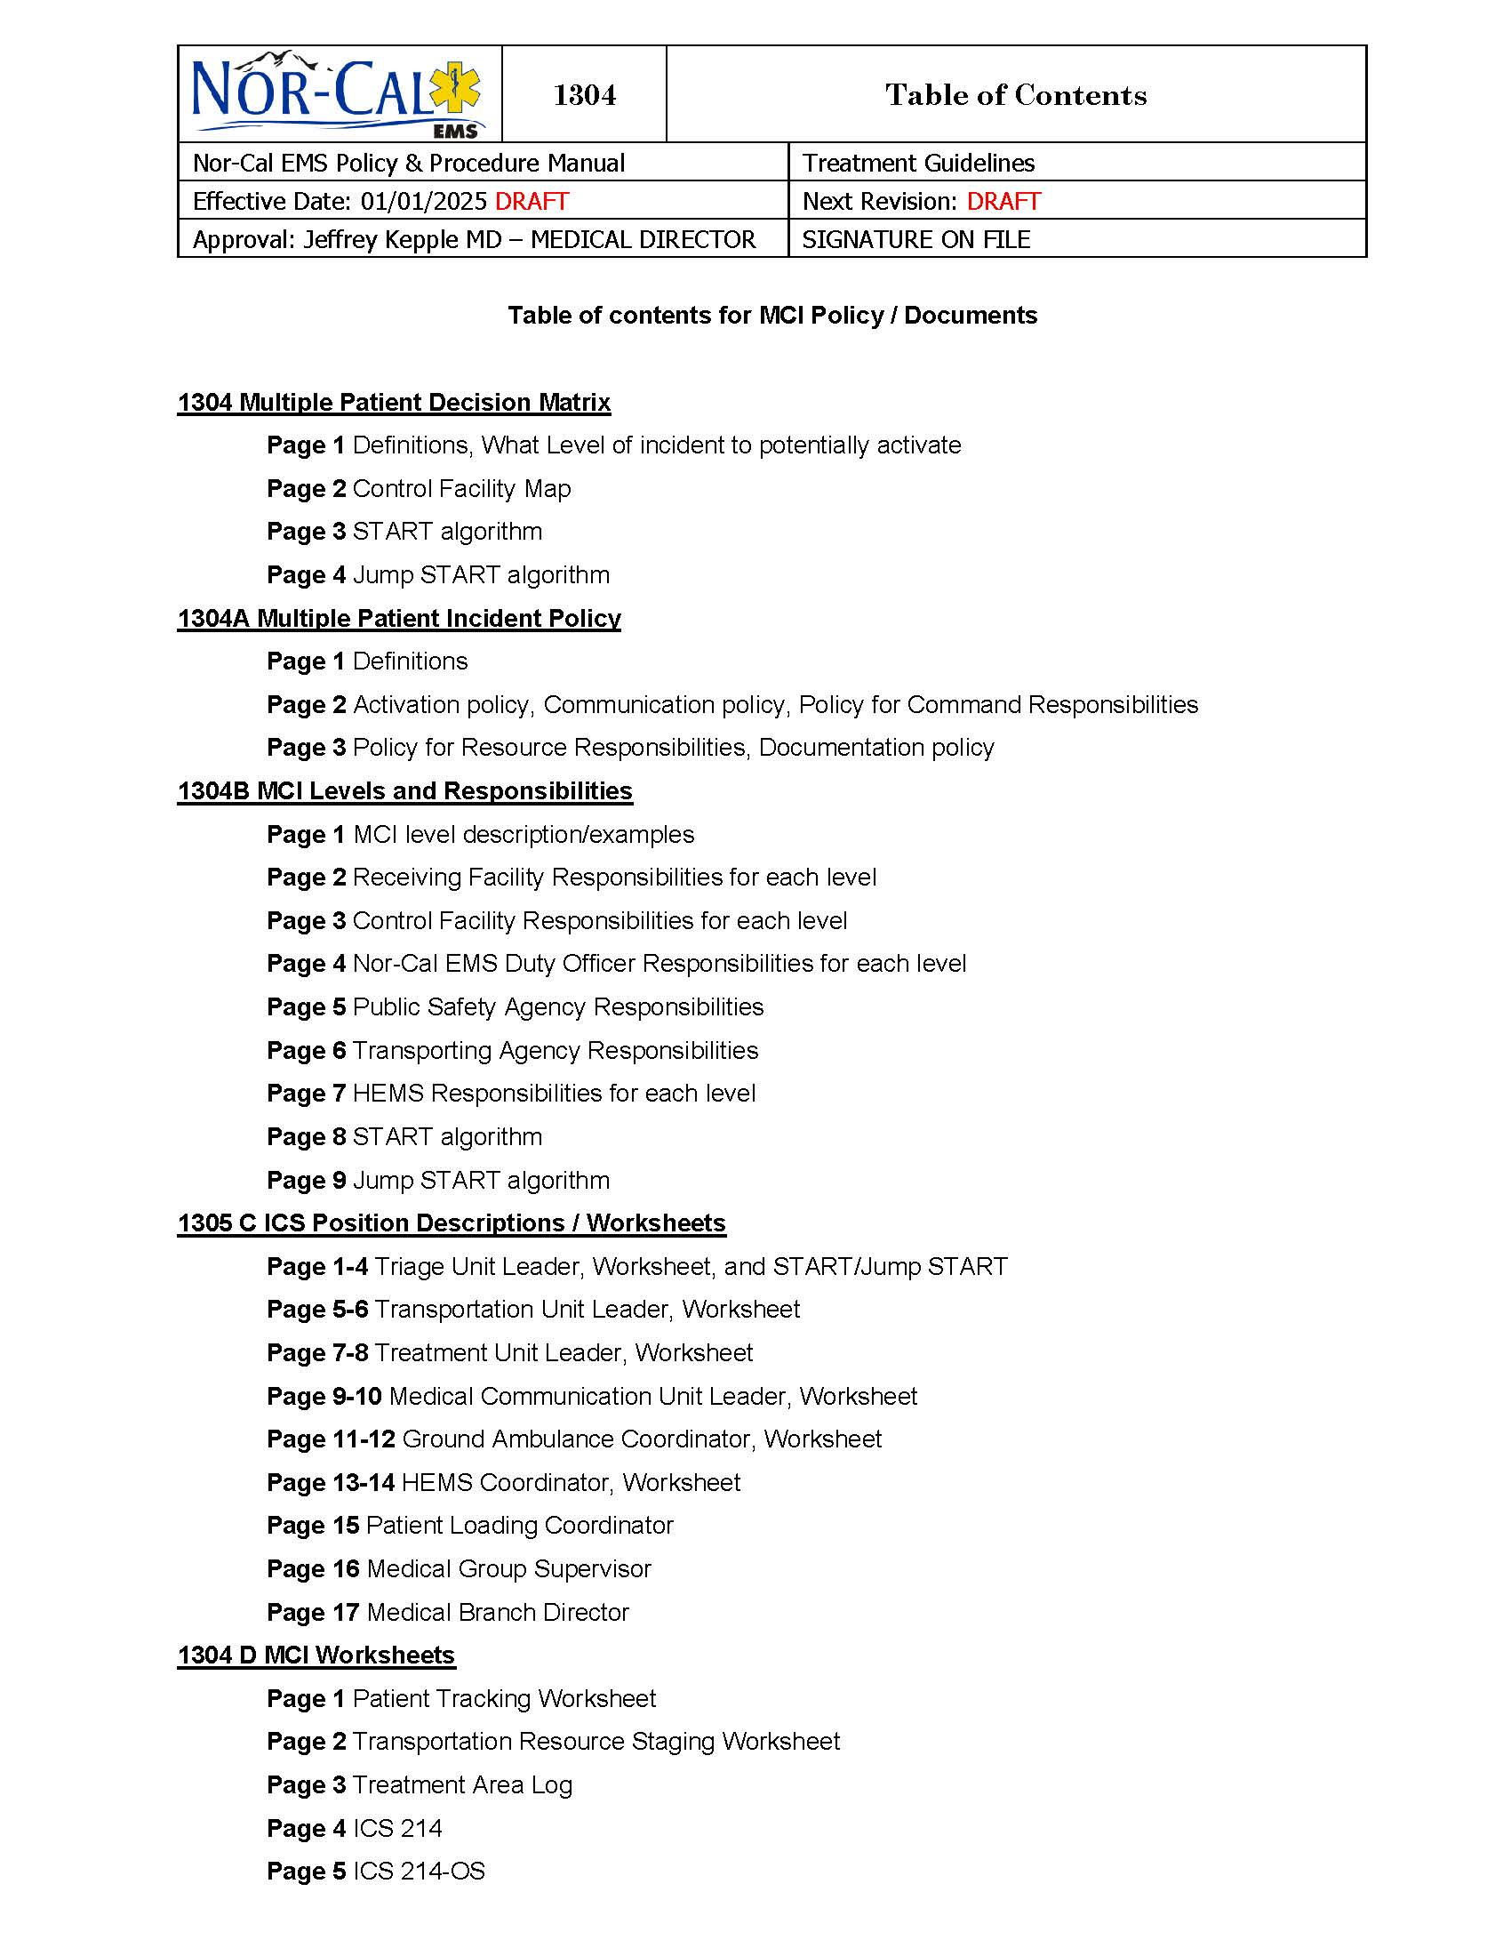
MCI Plan
Will replace what was the Region III MCI Plan.
Nor-Cal EMS will have a separate, but consistent MCI plan with all of Region III.
The new plan is very similar to the previous plan.
Will still be using START/RPM Triage
Will still be using ICS Structure, Command, and Roles
This will go into effect on March 1, 2025

Slide 16

Provider Updates

Slide 17
Nor-Cal EMS Updates
1.) Please send in 2025 employee rosters ASAP, if not already done.
2.) Northstate PreHospital Conference is
June 21, 2025,
in Redding.
3.) Please invite your staff to attend MAC. We want providers to have input.
4.) Will be including run reviews at future MAC meetings when time allows
5.) Inspection scheduling

Slide 18
Ground Ambulance
Inspection Scheduling
*New for 2025*
Month | County
May | Modoc
June | Plumas
July | Trinity
August | Sierra
September | Lassen

Slide 19

Open Discussion

Slide 20

Run Review

Slide 21
Run Review: Overview
Call Type: Animal Bite
Requested code 2 for patient evaluation; Fire arrives at scene and requests EMS upgrade to code 3
Fire requests HEMS; all decline due to weather
Primary Impression: Traumatic Injury
Primary Symptom: Altered Mental Status
Other Symptoms: Pain, Repeated Falls, Weakness, Skin Rash
Barriers to Care: Uncooperative, Physically Impaired, Hearing Impaired
Time to Scene: 47 minutes
On Scene: 36 minutes
Transport to Destination: 1 hour 35 minutes
F.A.S.T exam performed: 14 minutes after arrival (Non-conclusive)
Repeated Documentation of GCS every 10-12 minutes: Noted as worst of 4, best of 10
Initial Blood Glucose at 29mg/dL obtained by Fire PTA of EMS
90 YOF lives with her 2
adult children who are both
gravely disabled.
Pt has been on the ground for approximately 3-5 days with an open LT femur fracture.

Slide 22
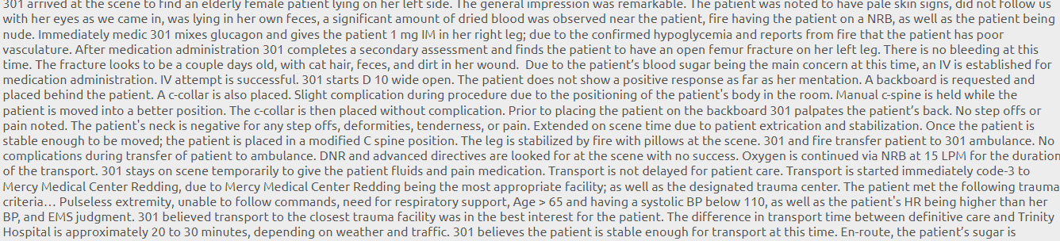
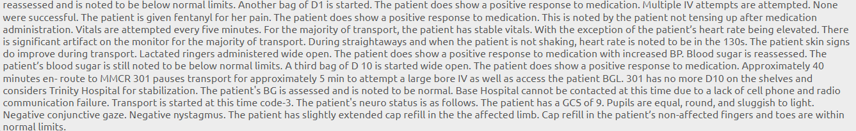
Run Review:
Narrative

Slide 23
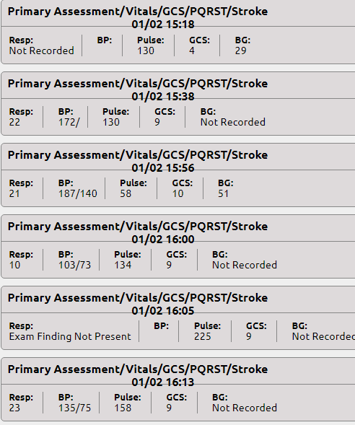
Run Review: Secondary Assessment
Run Review: Some Vitals
Run Review: Trauma Triage Criteria
Over Age 65
SBP less than 110mmHg
Respiratory Distress
GCS less than 13
Special High-Resource Healthcare
EMS Provider Judgement
Run Review: Treatment
Oxygen, Blood Glucose (1 x PTA of EMS; 6 x en route to ER)
Cervical Collar, Cardboard Splint to LT leg
Wound Care
D10 x 3
Fentanyl @ 25mcg x 3; total of 75mcg
Fluids W/O with TVI @ 400mL
Warming Measures
Cardiac Monitor, SpO2, ETCO2

Slide 24
Run Review: Treatment Guidelines & Policies to Consider
Altered Neurological Function
Trauma Care
Fever/Sepsis
Pain Management
Diversion/Destination
Any others?

Slide 25
Run Review: ER
Initial Exam per Medical Record: Temp was 35.9C, 134/61, HR 163, 90% on 15L NRB at 20 breaths per min. Check in time of 1739. Respirations described as labored and the patient was in "acute distress." She was intubated directly after the primary assessment, @ 1750. ED put her GCS at 3 upon arrival.
Laboratory Results WBC: 11.0 Hemoglobin: 10.1 (L) Hematocrit: 33.9 (L) Platelets: 294 MCV: 95.3 Sodium: 136 Potassium: 3.4 Chloride: 96 (L) CO2: 26 Anion Gap: 17 Glucose: 371 (H) BUN: 36.0 (H) Creatinine: 1.09 Calcium: 8.1 (L) Magnesium: 2.1 Total Bilirubin: 1.62 (H) ALT: 66 (H) AST: 147 (H) Alk Phos: 97 Lipase Level: 6 (L) Lactic Acid: 5.93 (!)

Slide 26

To Get CEU’s:
Use QR Code or Link to:
Fill Out Evaluation & Answer Test Questions
Use the email you want your CEU’s sent to
Each Run Review will be worth one (1) CEU Hour
Link to get CEUs will be open for 2 weeks following the completion of the MAC Meeting
Sign roster (in chat), evaluation form, and test must be completed to be eligible for CEU’s
If you miss the 2-week deadline, you will not be eligible for CEUs for that meeting
Include Name, Certification #, and Level
https://forms.office.com/r/H2va7UQ3LE

Slide 27
MAC Informational Resources
Will be emailed at least 2 weeks prior to scheduled meeting
Will include proposed updates to the policies, procedures, or treatment guidelines
Invite providers for input
Will include agenda for the following MAC meeting and zoom link
Will include guided notes correlating with information in presentation to use when reviewing

Slide 28
Meeting Dates & Times
February 12, 2025
1000 to 1200
April 9, 2025
1000 to 1200
June 11, 2025
1000 to 1200
August 13, 2025
1000 to 1200
October 8, 2025
1000 to 1200
December 10, 2025
1000 to 1200

Slide 29

Thank you for your time and input!

